Slide 1
How to use the
Ebook Tool Bar in Ebscohost Ebooks
By
Gloria Creed-Dikeogu

Slide 2
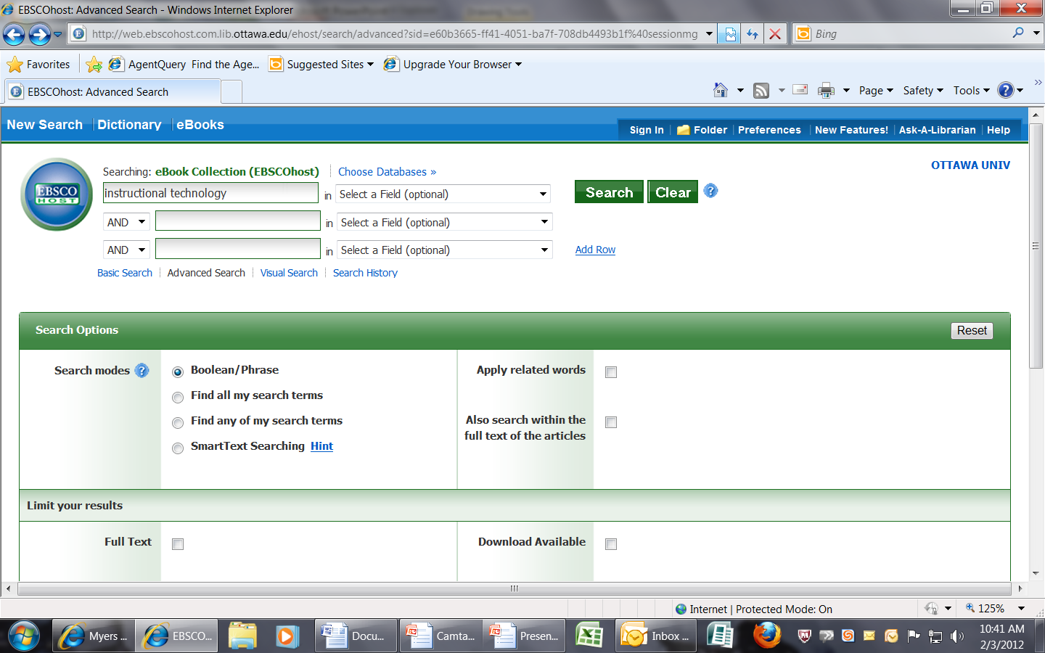
In Ebsco Ebooks choose your topic and place it in the search box. Then click Search.

Slide 3
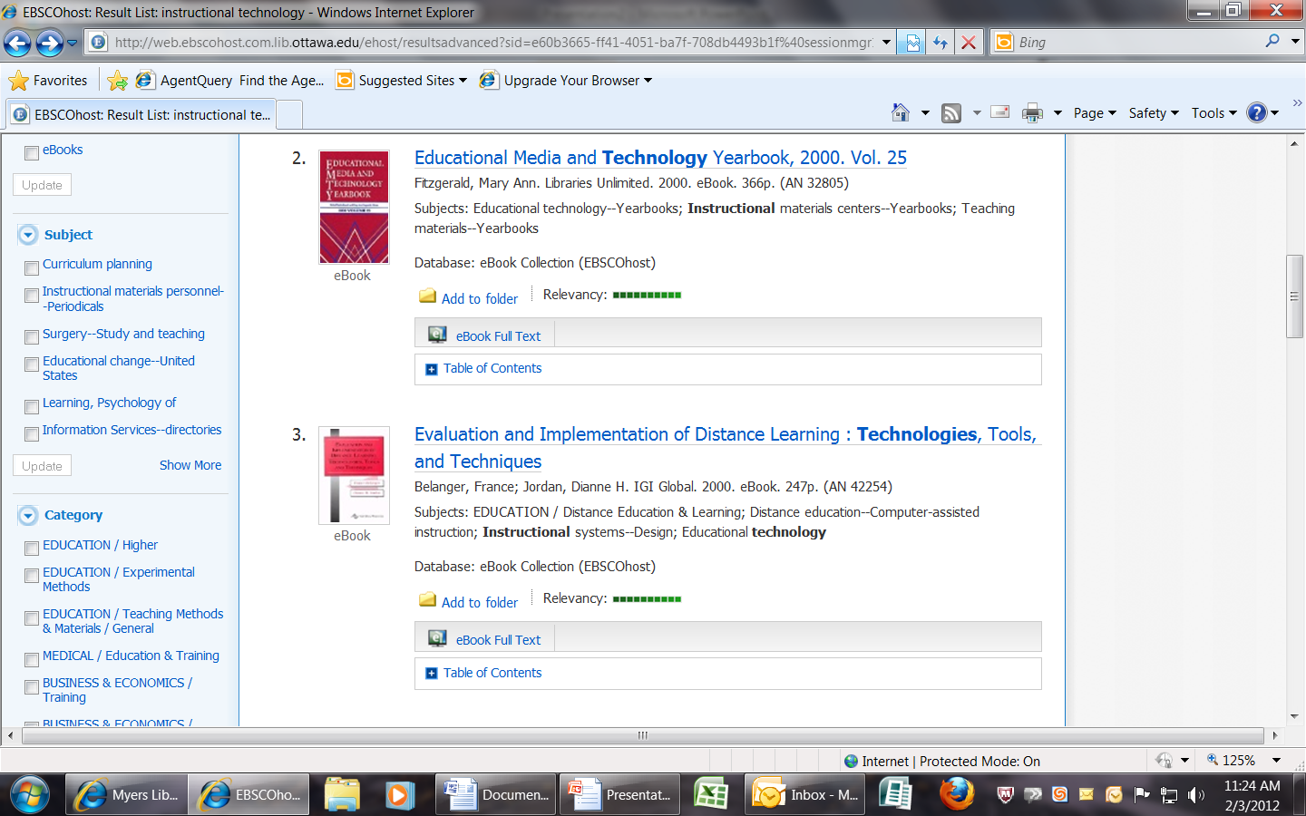
To expand your subject and topic searching , use the topic and category tools on the left hand side of the page.
Find related subjects
Find related topics

Slide 4
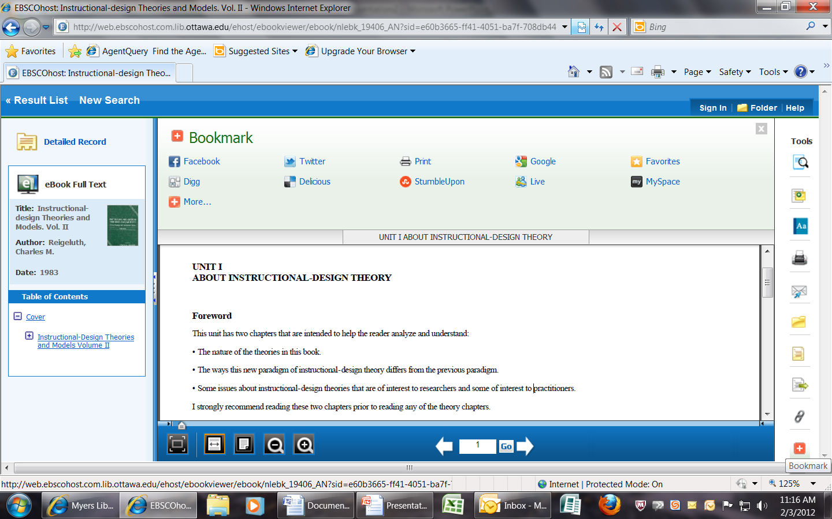
If you would like to bookmark the ebook, then you can click on the red “+” sign on the Tool bar and you will be able to do so.

Slide 5
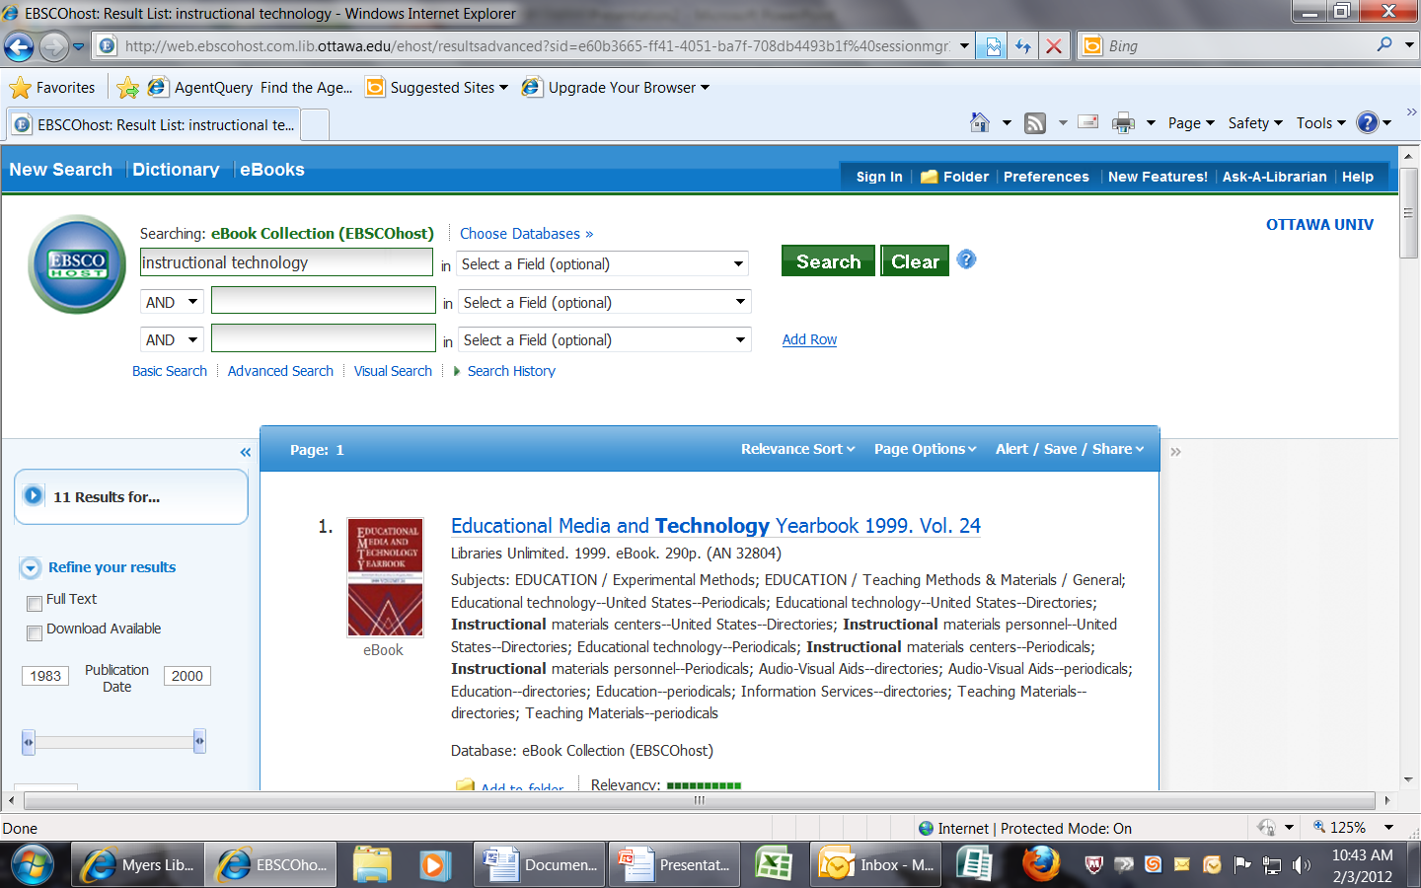
11 Ebooks were found on your topic.

Slide 6
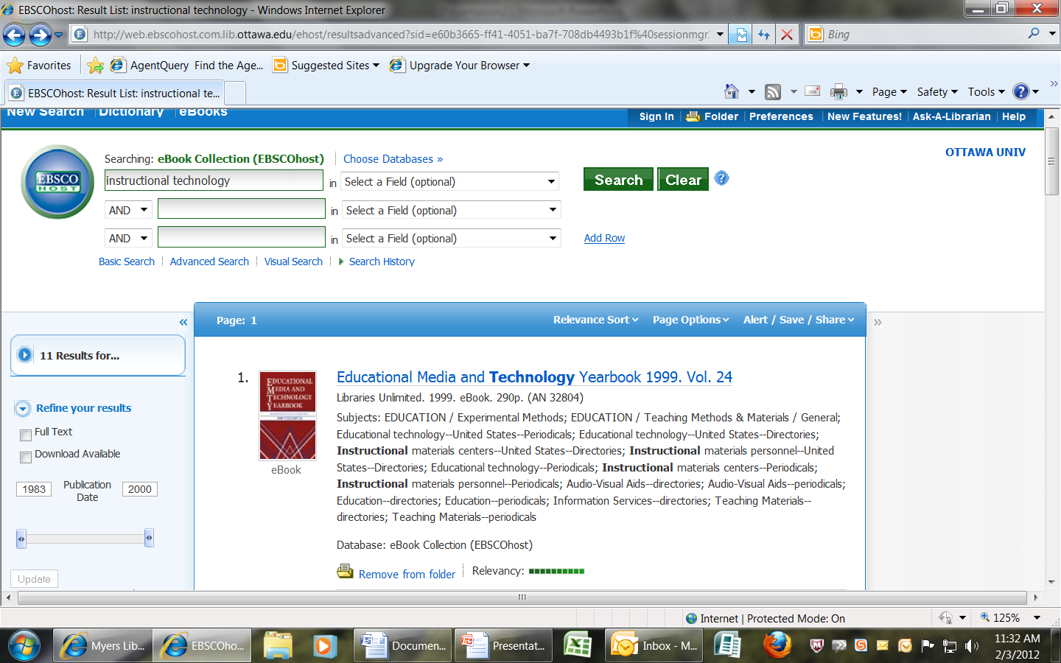
You can choose to add items you want to a folder if you choose not to open your ebooks at present.

Slide 7
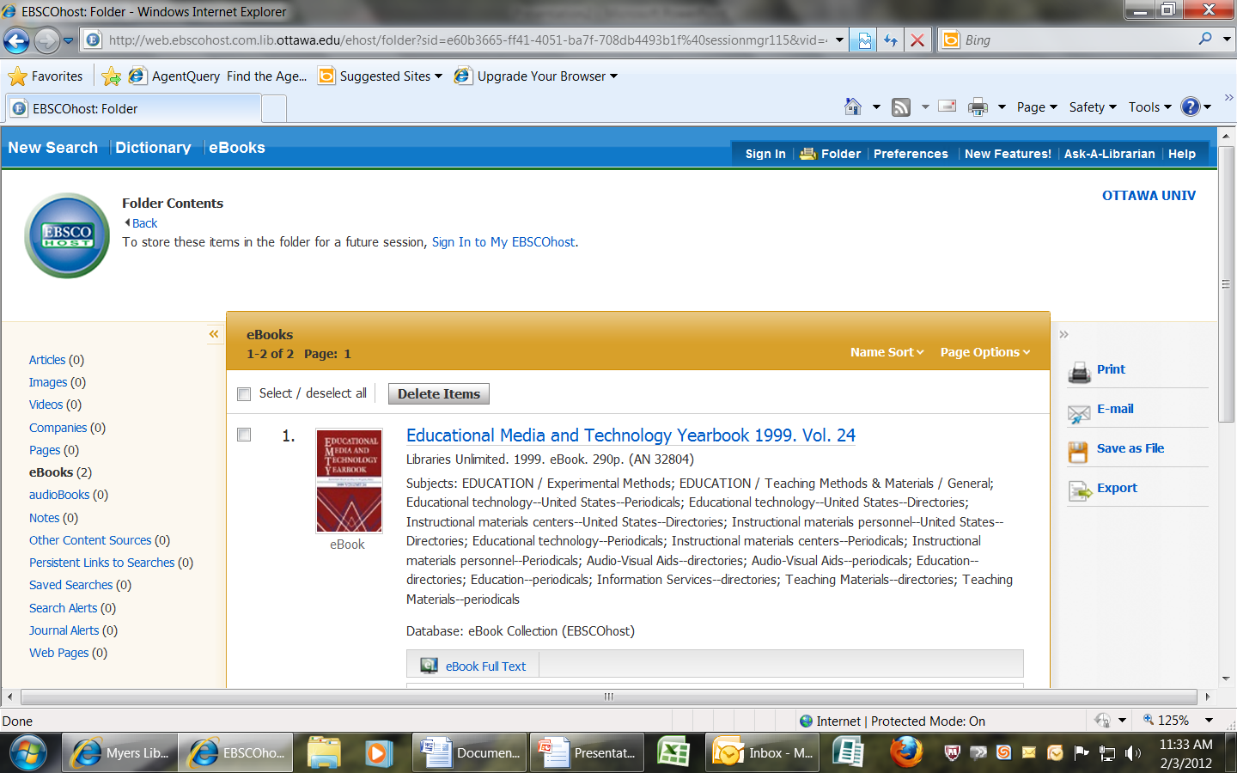
Open the folder and you can now select the items you want by checking the boxes next to them and then you can choose to print, email, save or export items.

Slide 8
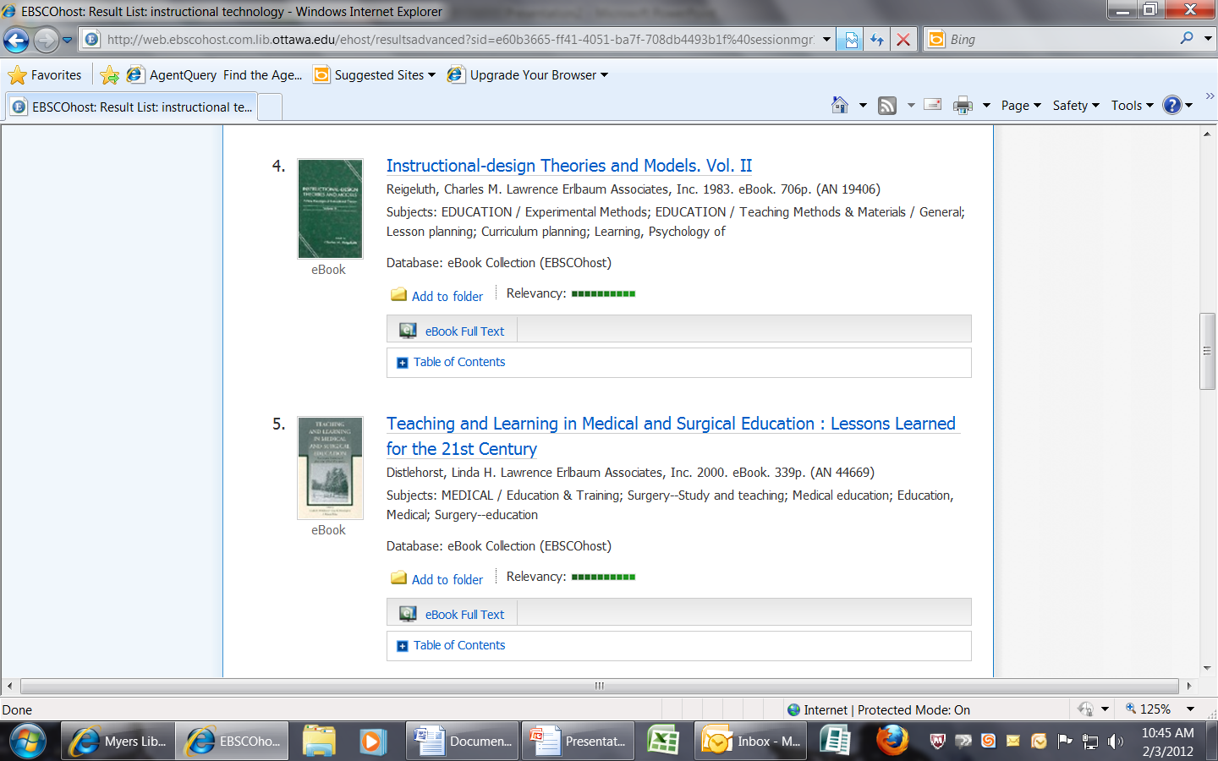
Make your choice and now open your ebook by clicking on the “Table of Contents” link in the white bar that you see below the “ebook Full-Text” gray bar.

Slide 9
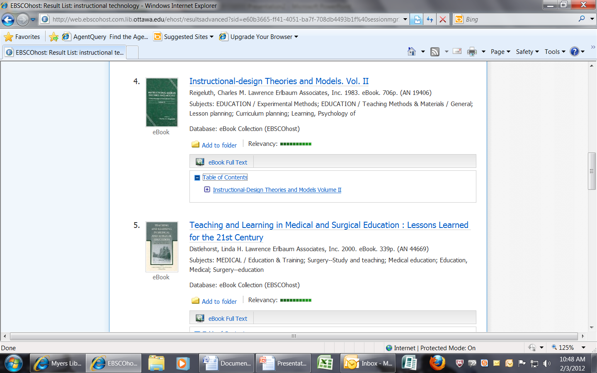
The table of contents you clicked on is now open. See the “+” sign next to it. This means that you can now open the ebook.

Slide 10
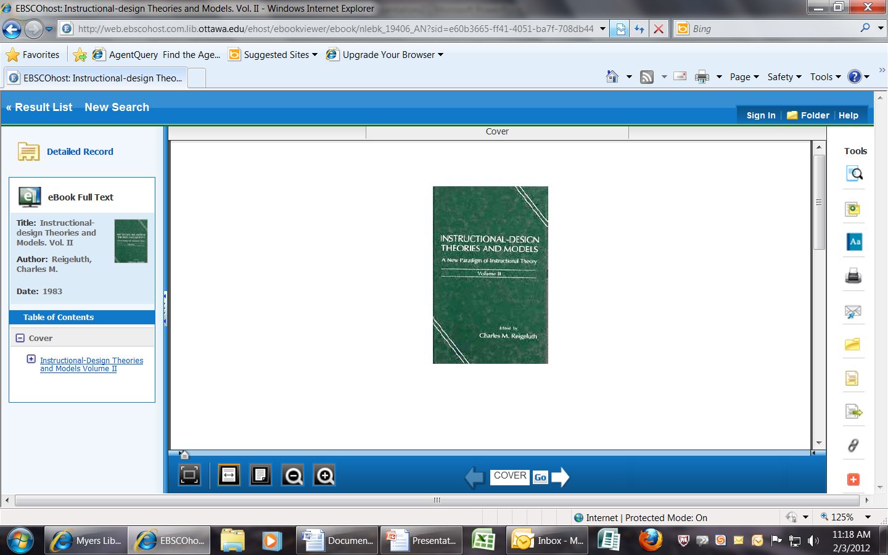
You can see the cover of the ebook you are reading by clicking on the gray cover link on the left hand side of the book, under the “Table of Contents”

Slide 11
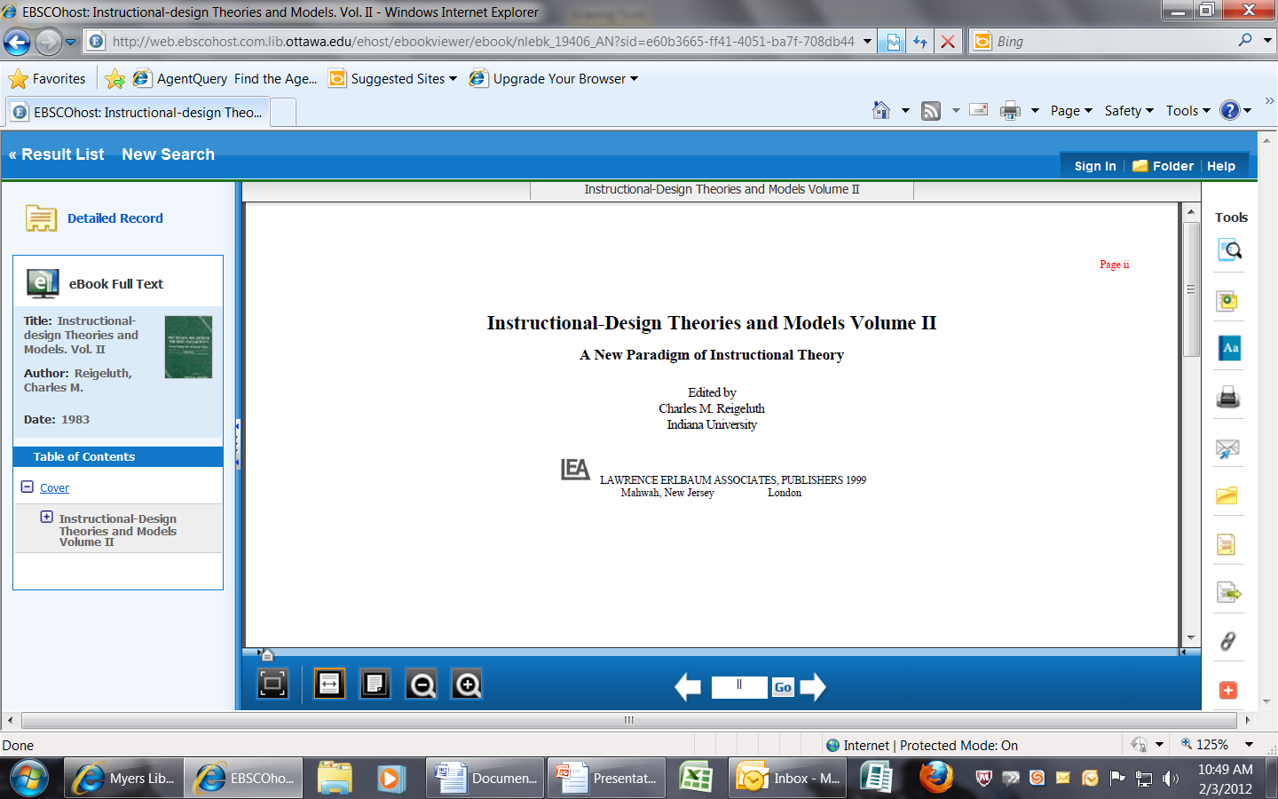
Open your ebook. You will see the ebook title and full-text information next to it on the left and your tools on the left hand side. There are also two arrow keys that can be used to scroll through your book. Click on the right arrow to scroll forward.

Slide 12
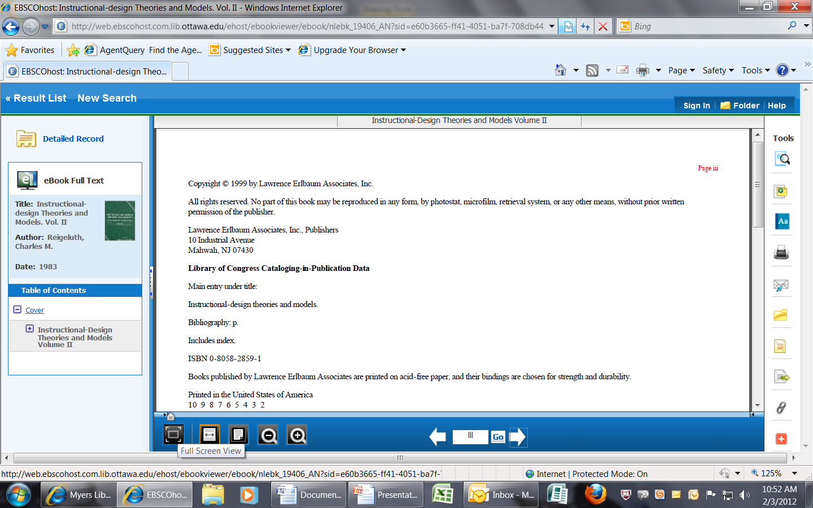
Click on the buttons on the blue bar to create a full-screen view of the book or to fit page width, zoom-in or zoom-out of the book. The box in the middle of the arrows gives you the ebook page number.
Fit Page Width
Fit Page
Zoom-out
Zoom-in

Slide 13
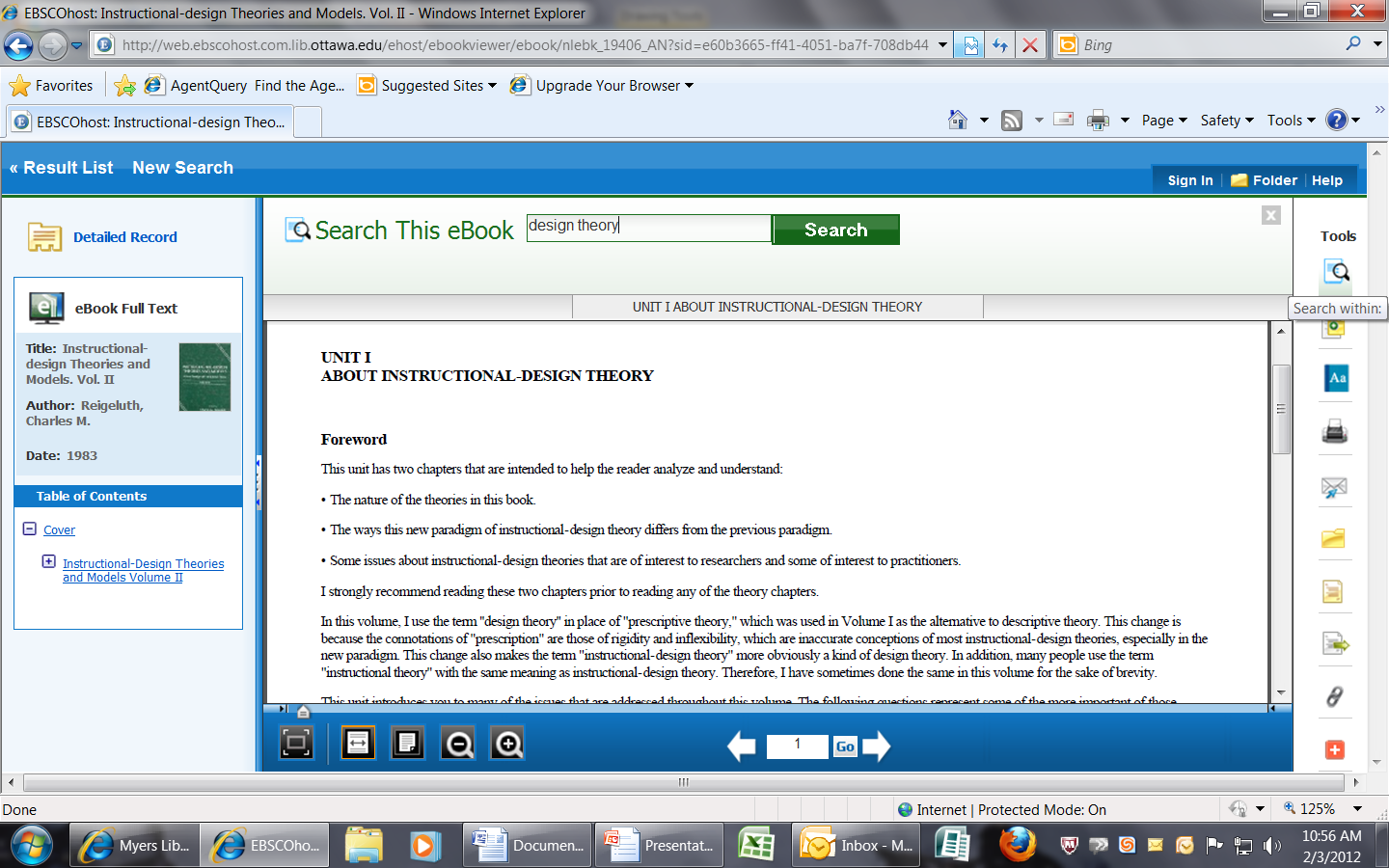
The first tool on the right hand side bar allows you to search for text within the ebook.

Slide 14
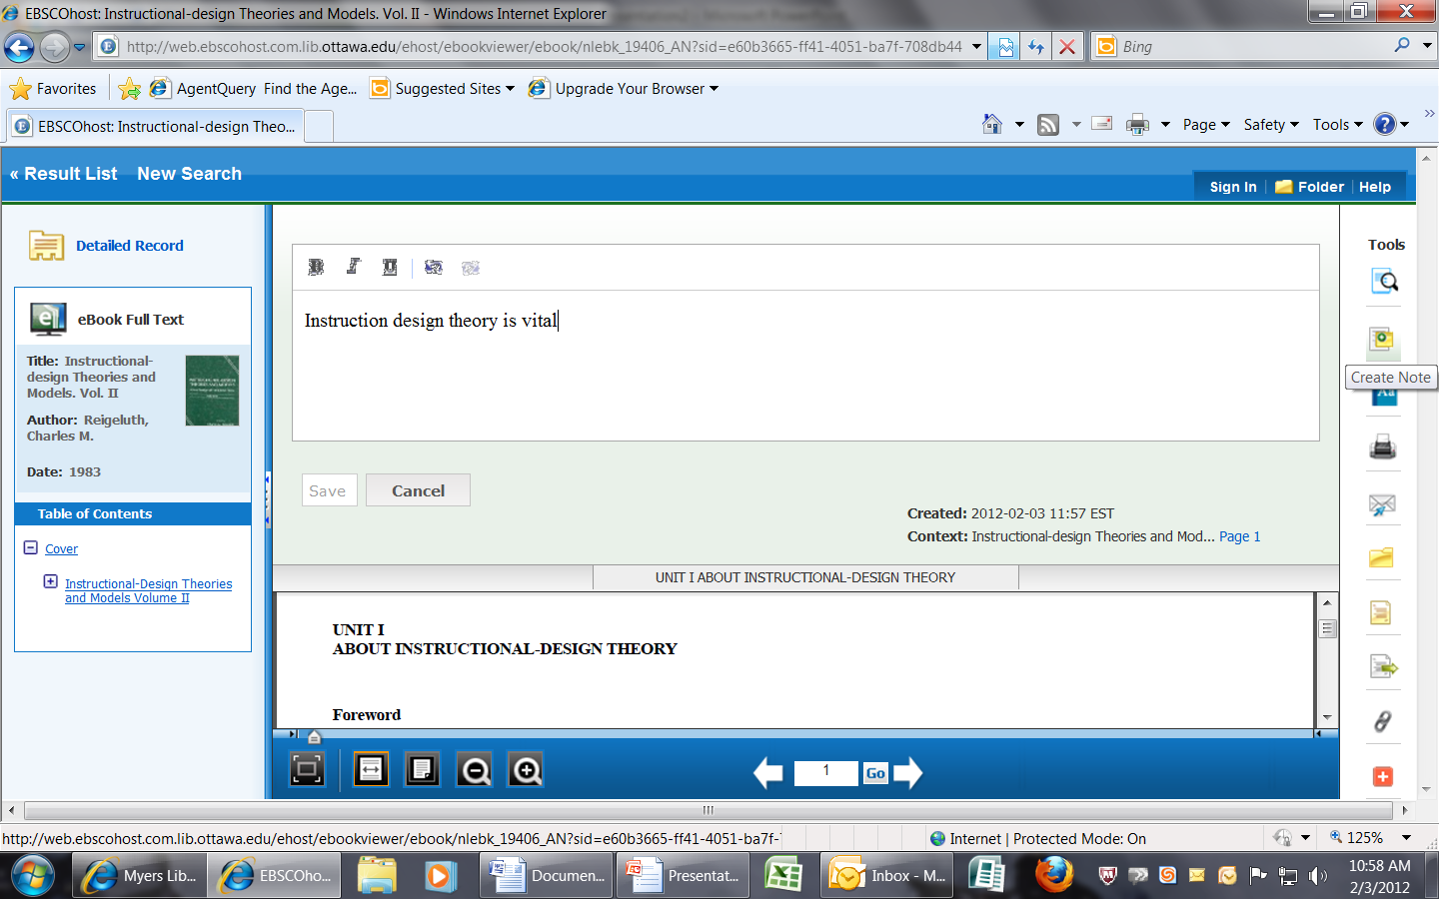
The second tool allows you to create a note in your ebook that you can keep and save.

Slide 15
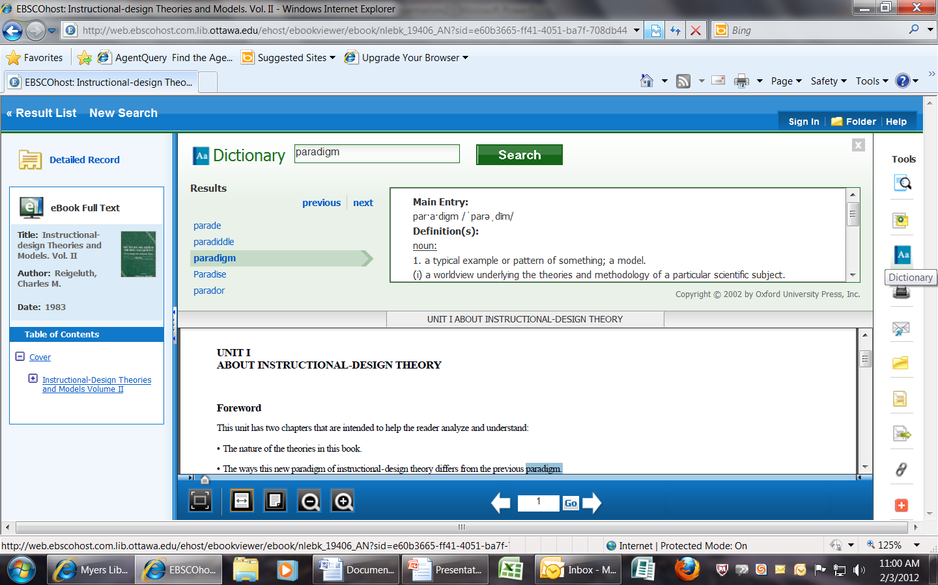
The third icon in tools allows you to find a word that you need a meaning for, in the dictionary.

Slide 16
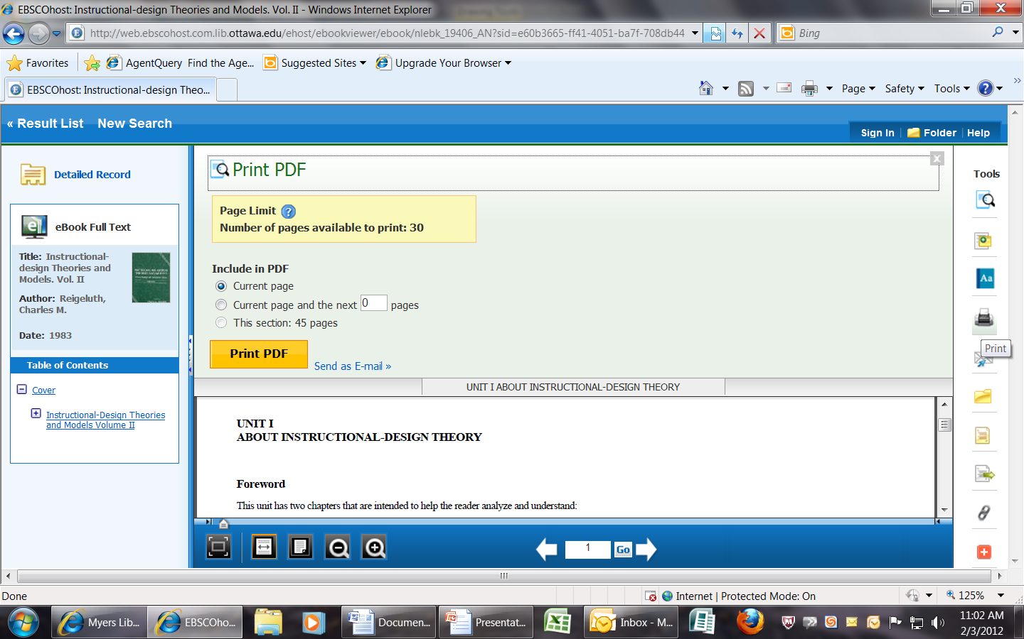
The fourth icon on the tool bar on the right hand side is the print icon. If you click on it, it will tell you how many pages you are allowed to print. That number will change depending on where you are in the book, as it is determined by copyright law.

Slide 17
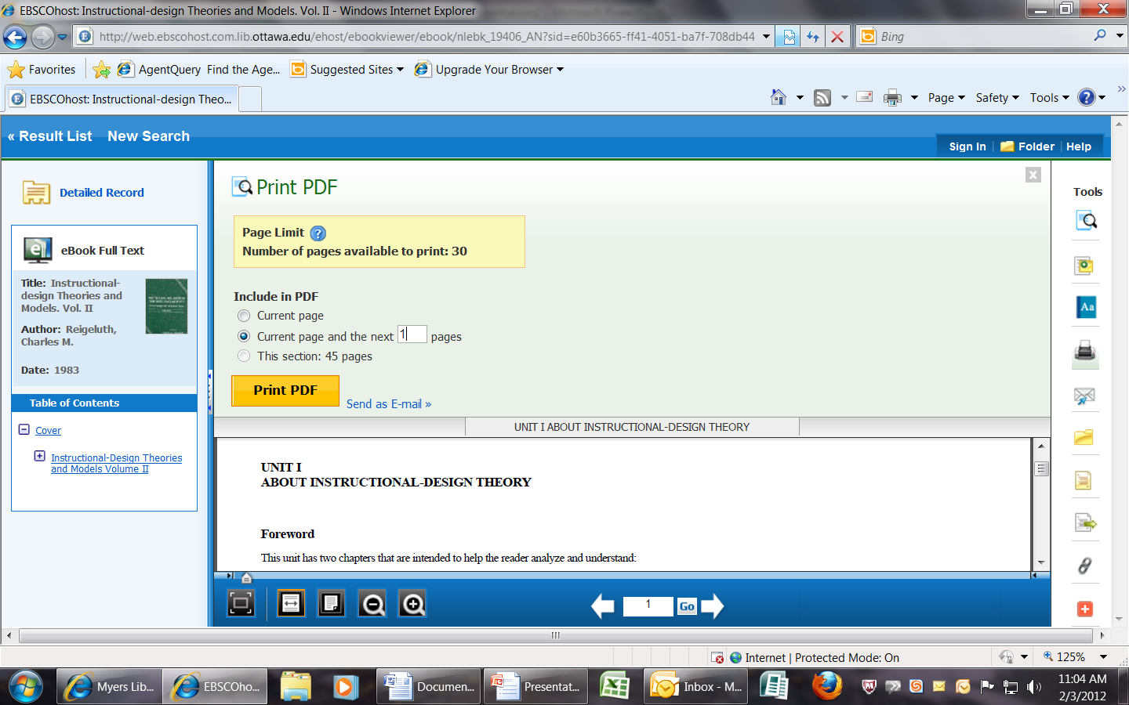
To print page one you can enter the number in the box.

Slide 18
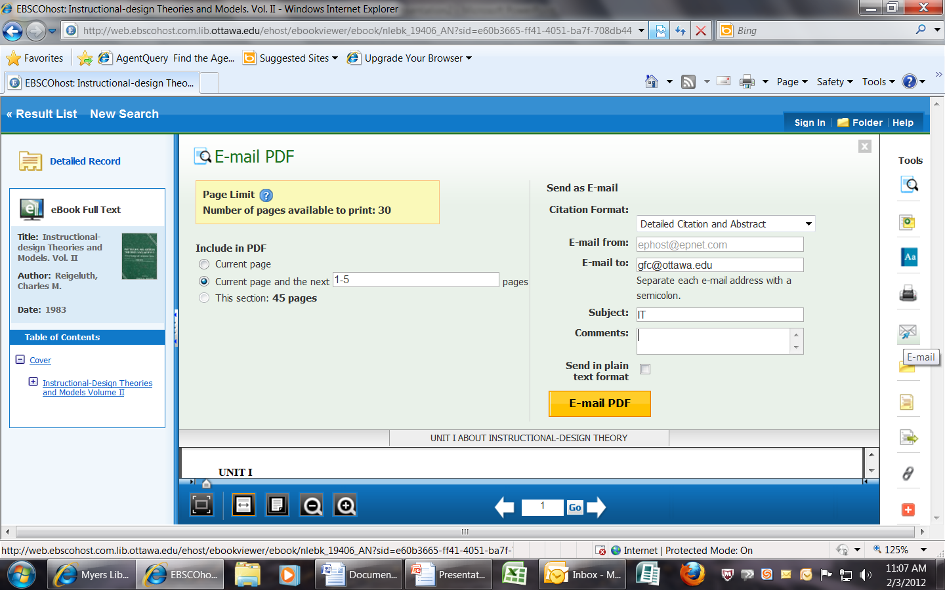
If you click on the email icon on Tools bar then you can email the pdf to yourself or someone else, but make sure that you fill out all the necessary information before doing so.

Slide 19
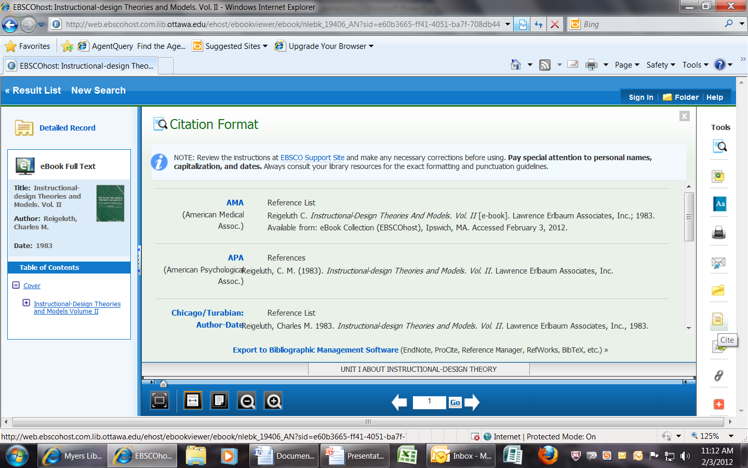
If you click on the “Cite” icon on the Tools bar, you will be provided with the citation for this ebook provided for you in various style formats.

Slide 20
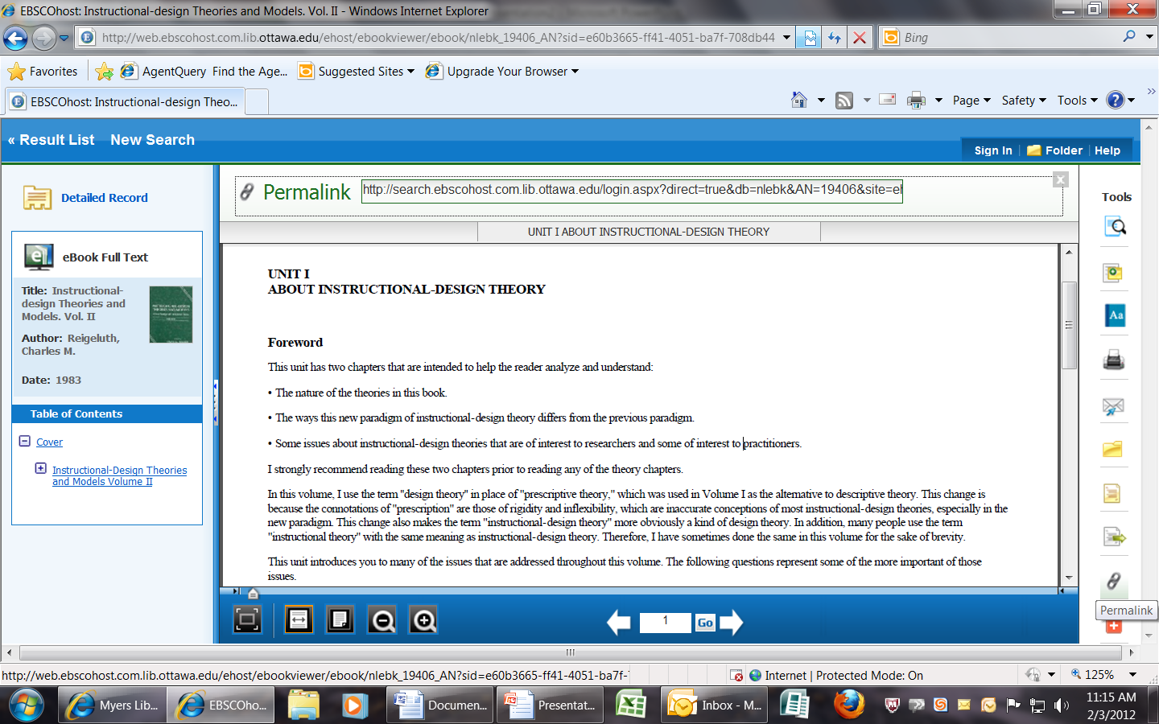
If you need the permalink for this ebook, it is provided for you by clicking on the permalink icon on the Tools bar.

Slide 21
Do you have any questions???
If you have any further questions about the databases or Ebscohost ebooks, please contact our librarians via email at:
library@ottawa.edu
You may also call Gloria or Jan at the library:
Gloria Creed-Dikeogu x12536
Jan Lee x12535

