Slide 1
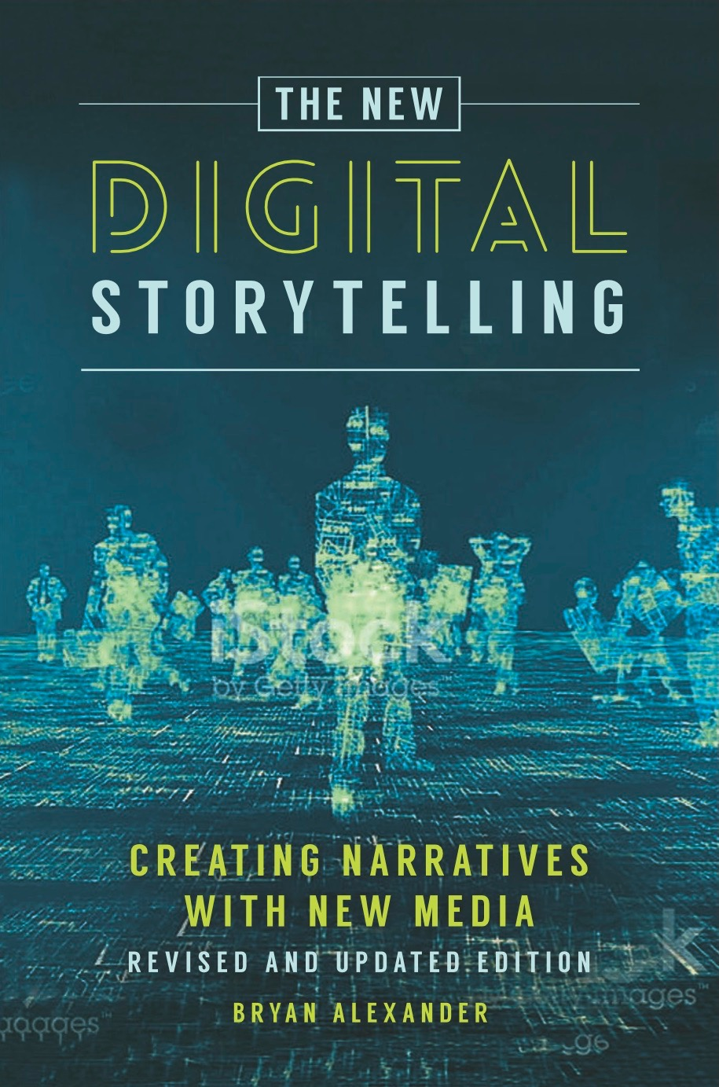
Storytelling for the 21st century

Slide 2
Table of contents
Storytelling
Classic digital storytelling
Newer forms (since 2004)
Educational uses

Slide 3
Why story?
Notes:
Huge part of the human experience
Often added to other parts as an enhancement or heuristic: journalism, marketing, politics
Every new tech
Education: storytelling has played a role in teaching and learning for millenia. Digital technology reframes that role and offers new possibilities.

Slide 4
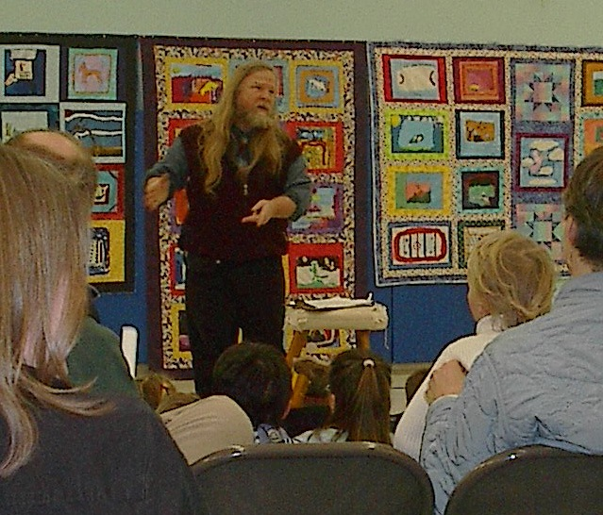
But wait, what's storytelling?

Slide 5
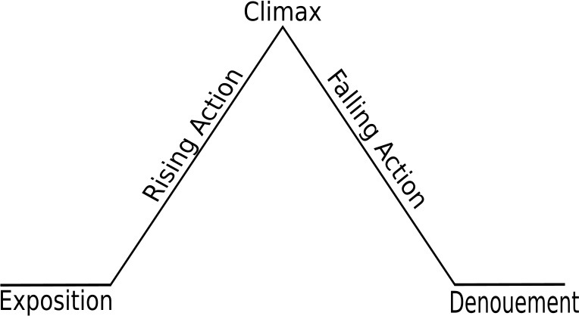
The Freytag:

Slide 6
A certain kind of personal experience

Slide 7
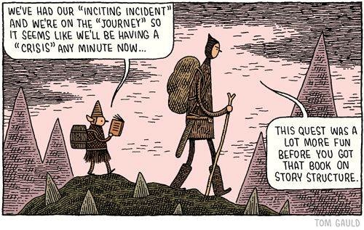

Slide 8
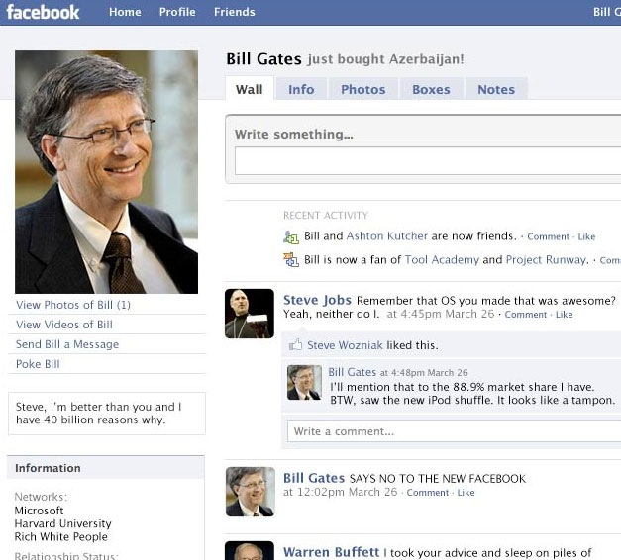
Or the personal?
Delight and instruct

Slide 9
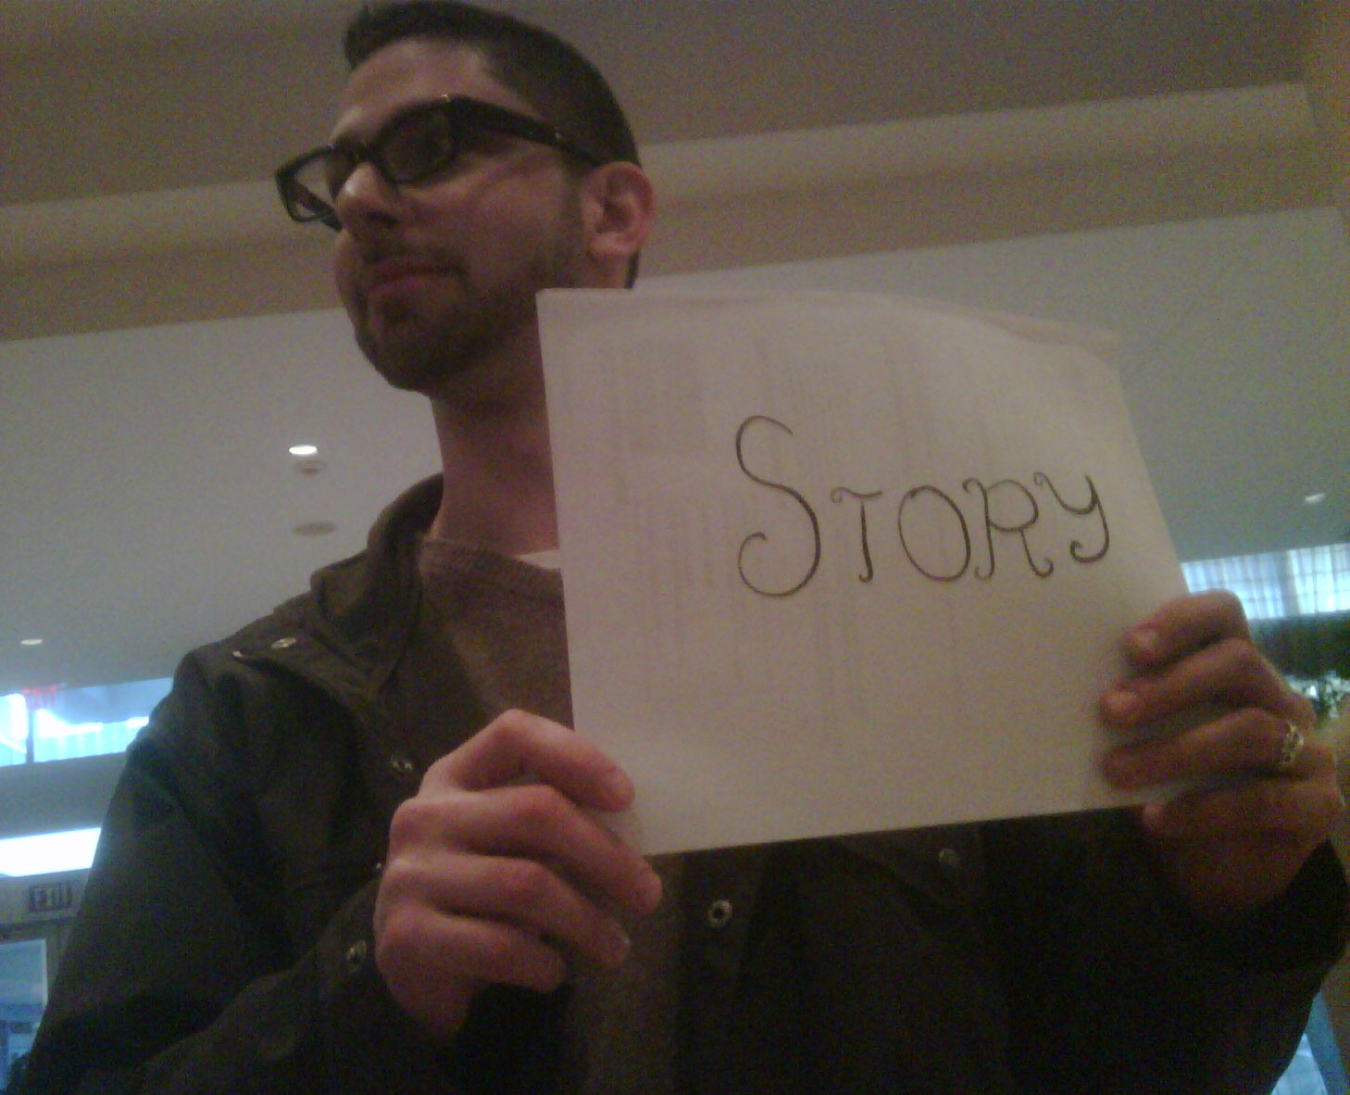
Stories are:
About someone important
About an important event
About what one does?
From the StoryCenter Cookbook
http://www.storycenter.org/cookbook.html

Slide 10
FICTION
NONFICTION

Slide 11
How much is mystery?
The last man on Earth sat alone in a room.

Slide 12
How much is mystery?
The last man on Earth sat alone in a room.
There was a knock on the door.
(Fredric Brown, “Knock”, 1948)

Slide 13
Mystery?
It was a bright cold day in April, and the clocks were striking thirteen.

Slide 14
Last night, I dreamt I went to Manderley again.

Slide 15
As Gregor Samsa awoke one morning from uneasy dreams he found himself transformed in his bed into a gigantic insect.

Slide 16
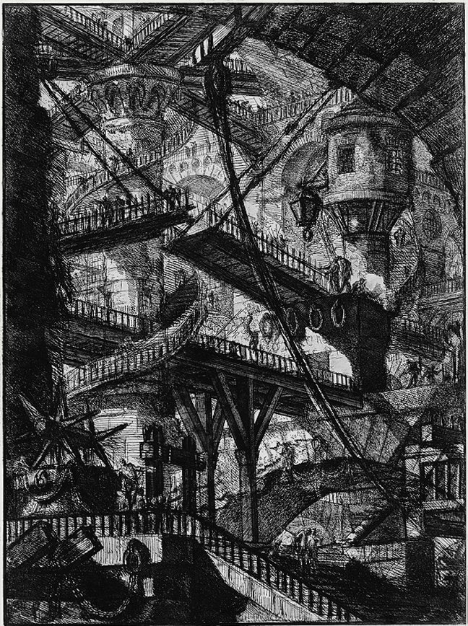
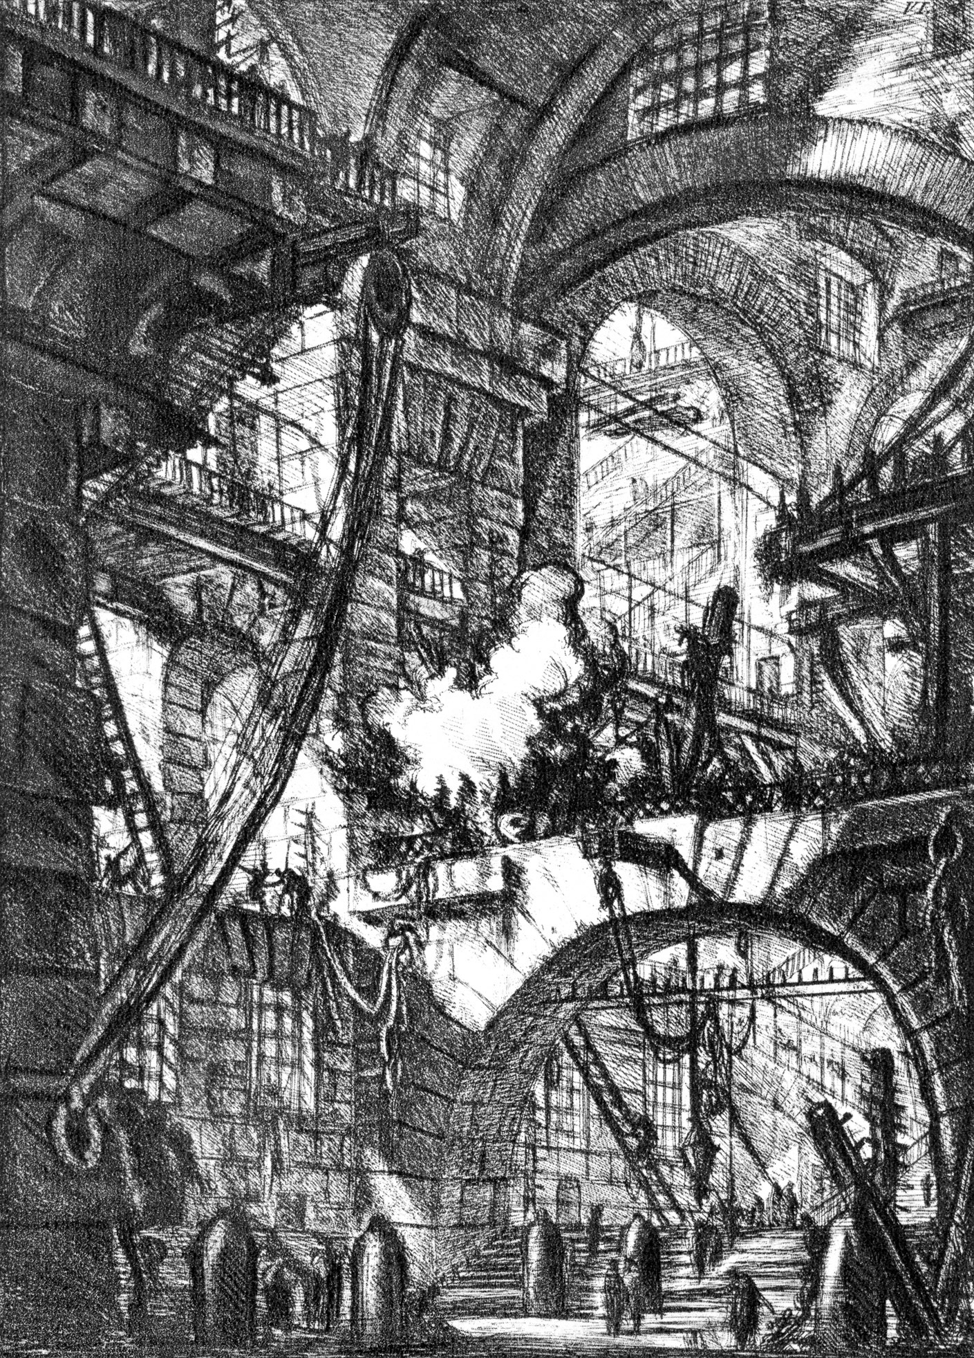

Slide 17
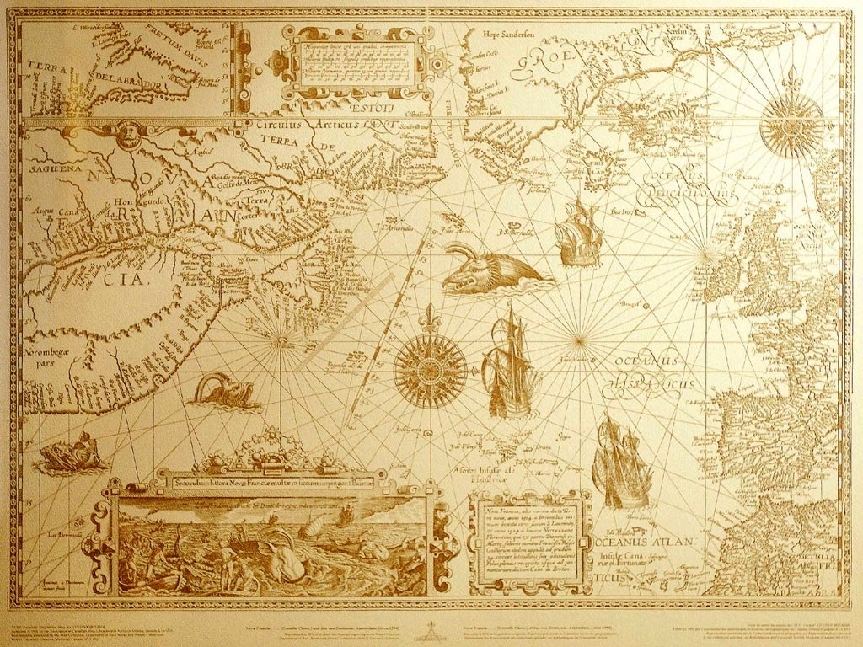

Slide 18
What isn’t storytelling?

Slide 19
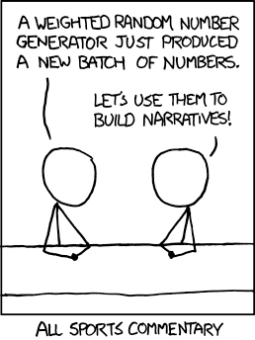

Slide 20
A list definition
For a given audience, a story is a sequence of content, anchored on a problem, which engages that audience with emotion and meaning.

Slide 21
Digital storytelling
In the 1990s
Web 1.0 storytelling
Hypertext
Multimedia
Browser-focused
Connected with offline, analog content (textbooks)
Evanescent

Slide 22
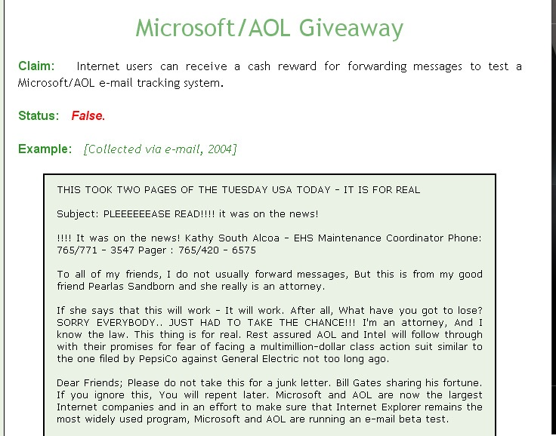
Web 1.0 era storytelling
Email chain letters, jokes
Social
Boundaries fuzzy
Microcontent
Virtual community facilitation (1980s on)
(Snopes.com)

Slide 23
Web 1.0 storytelling
Example: Dreaming Methods (2000ff)
http://www.dreamingmethods.com/

Slide 24
http://pinepoint.nfb.ca/

Slide 25
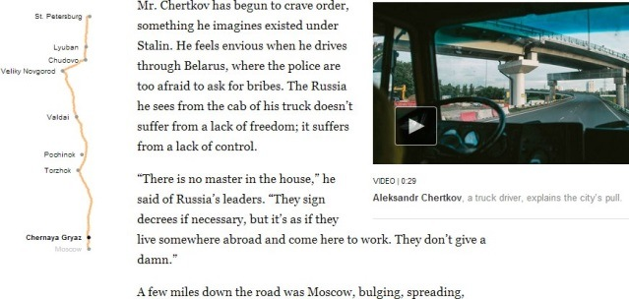
NYTimes, Snowfall

Slide 26
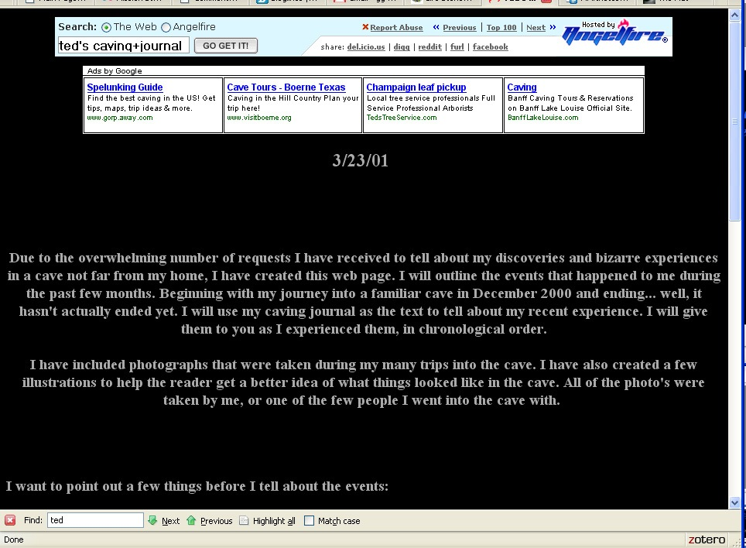
Example: “Ted’s Caving Journal” (circa 2001)
(one copy, from http://www.angelfire.com/trek/caver/page1.html)

Slide 27
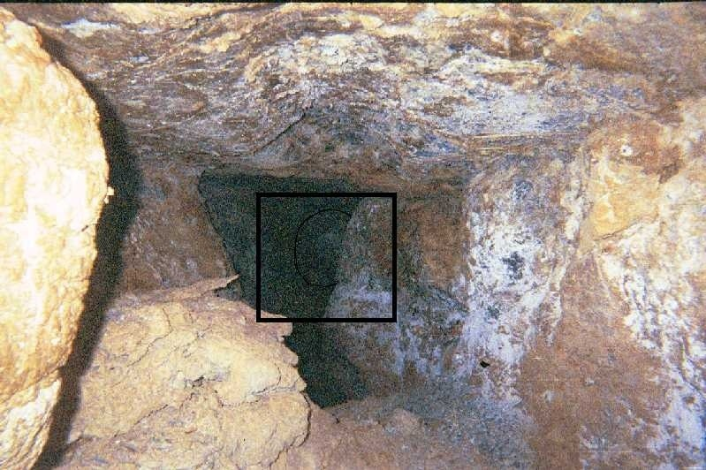
Features:
Multilinear
Multimedia
Browserish
Serial structure

Slide 28
Dear American:
I need to ask you to support an urgent secret business relationship with a transfer of funds of great magnitude.
I am Ministry of the Treasury of the Republic of America. My country has had crisis that has caused the need for large transfer of funds of 800 billion dollars US. If you would assist me in this transfer, it would be most profitable to you.
I am working with Mr. Phil Gram, lobbyist for UBS, who will be my replacement as Ministry of the Treasury in January. As a Senator, you may know him as the leader of the American banking deregulation movement in the 1990s. This transactin is 100% safe.
This is a matter of great urgency…
(http://www.thenation.com/blogs/jstreet/363133/bailout_satire)

Slide 29
Digital storytelling roots

Slide 30
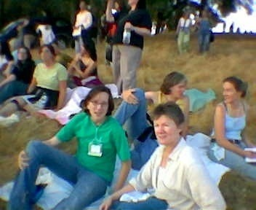
Digital storytelling roots
Effective:
Storytelling, not technology per se
Personal connection
Digital Storytelling
at Ukaiah, 2006

Slide 31
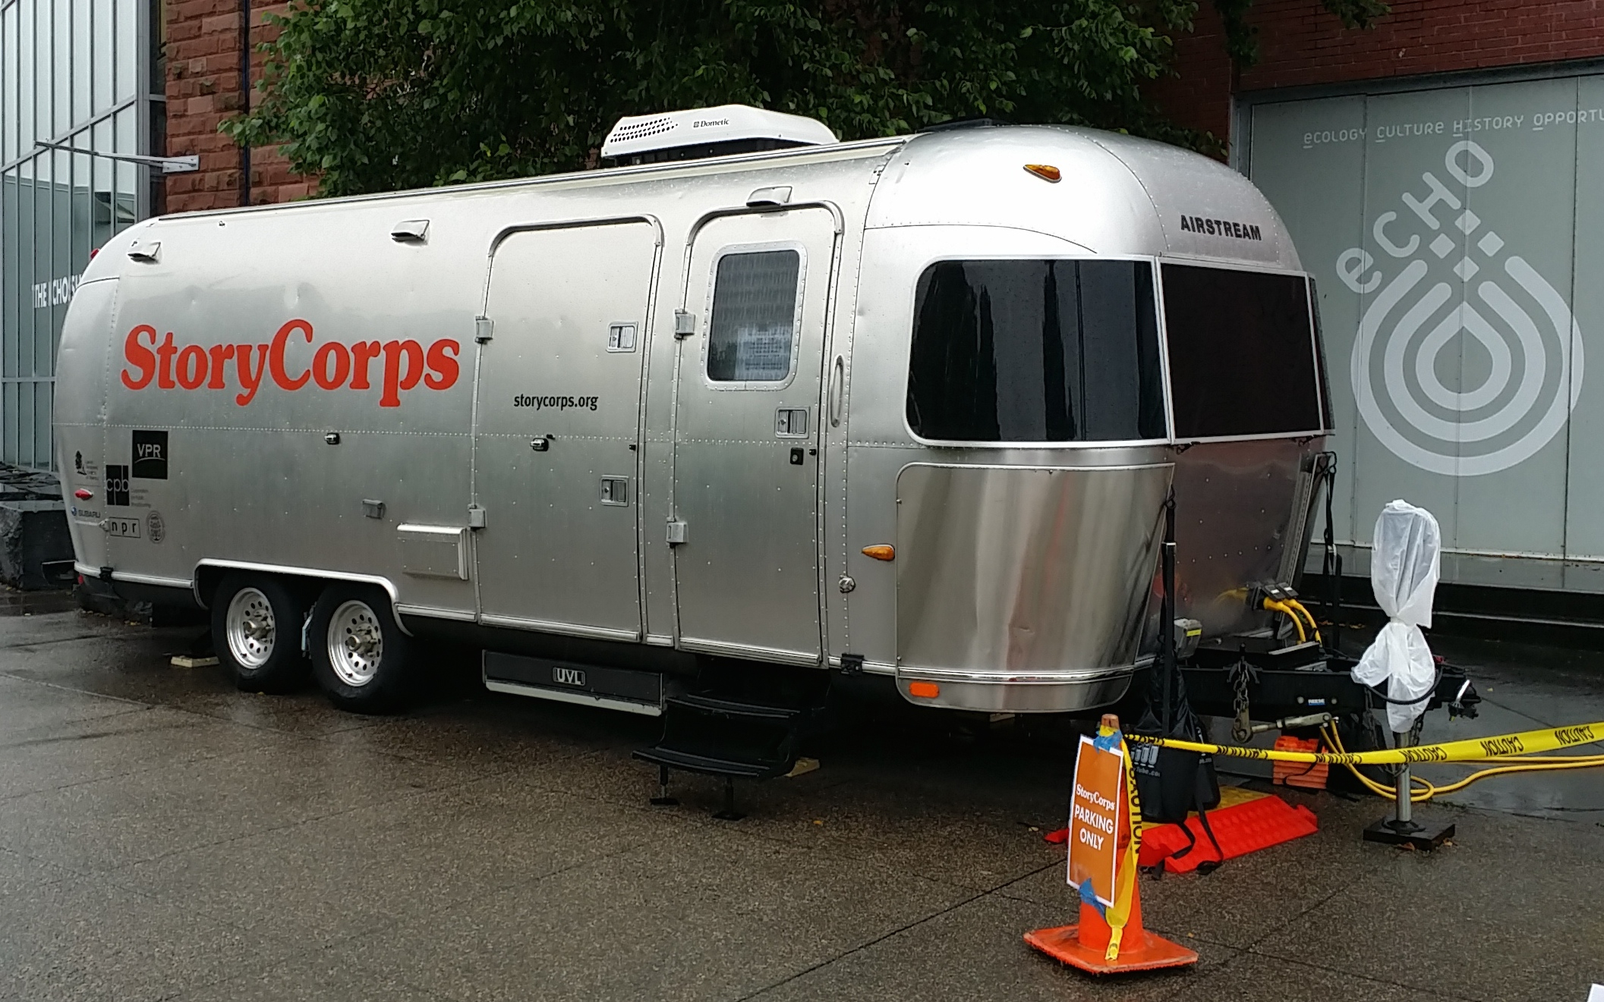
Digital storytelling movement

Slide 32
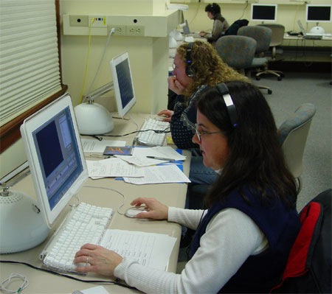
Digital storytelling roots
NITLE variant:
Non-personal narratives
Campus focus

Slide 33
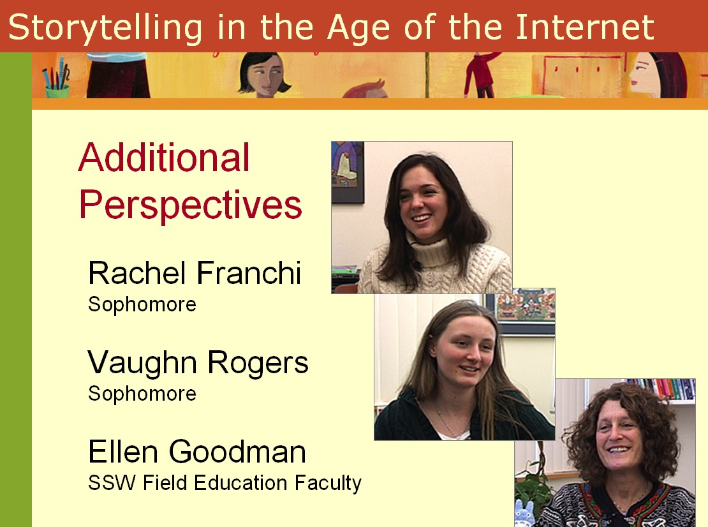
Educational projects growing
Community
Curricula
Support
(http://connect.educause.edu/Library/Abstract/StorytellingintheAgeofthe/42327)

Slide 34
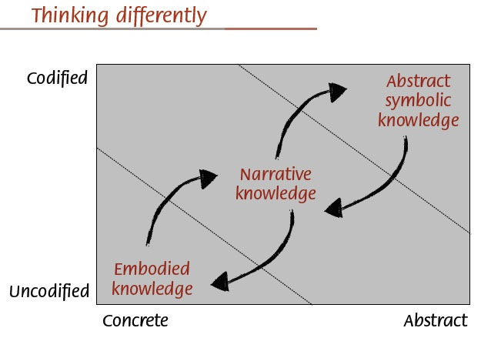

Slide 35
Pedagogical principles
Constructivism
Student voice discovery + development
Media defamiliarization
Outreach to media-drenched generation
Job skills

Slide 36
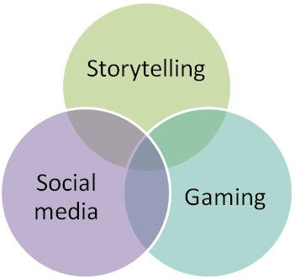

Slide 37
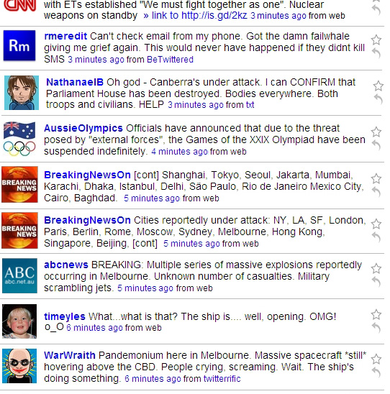
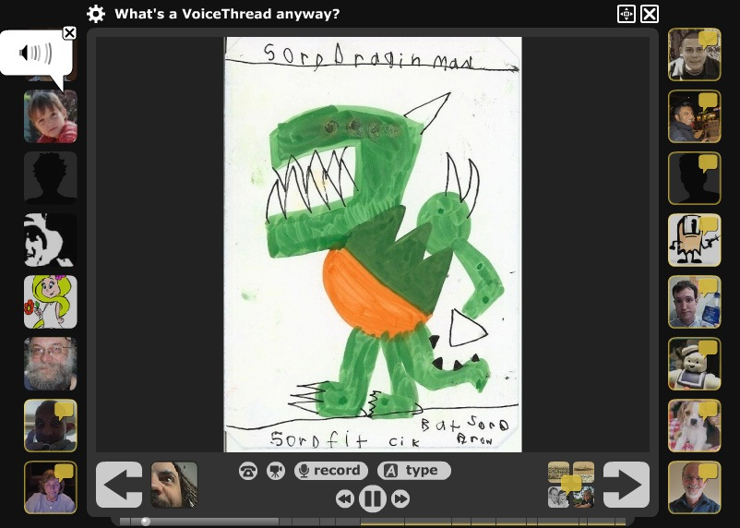

Slide 38
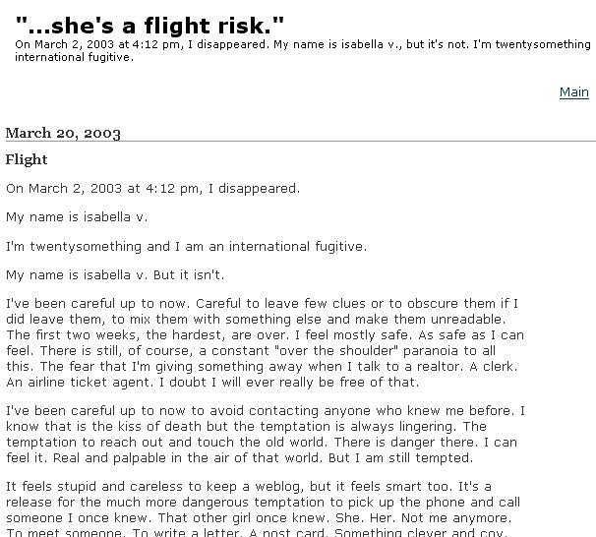
New forms for stories

Slide 39
Republish content via blog
Pedagogy
Social feedback
Publicity
Pepys Diary
Dracula Blogged
Ulysses and da Vinci per day
http://opinionator.blogs.nytimes.com/category/disunion/

Slide 40
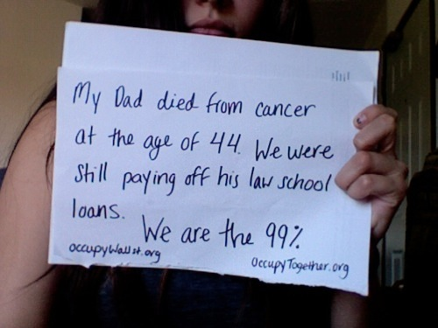

Slide 41
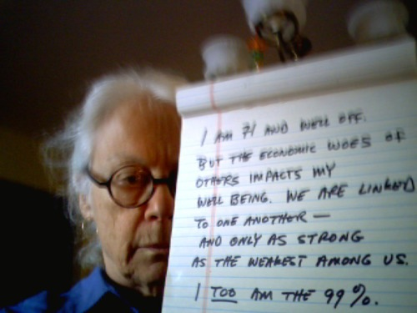

Slide 42
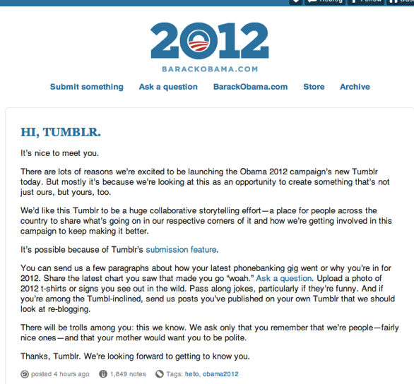

Slide 43
Bookblogging
Extended networks
Support wikis (example: Pynchon)
William Gibson lost his Node

Slide 44
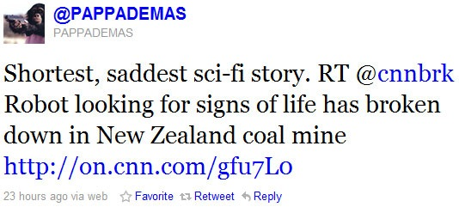

Slide 45
The six word exercise
For sale: baby shoes, never used.

Slide 46
The six word exercise
Parodied on Twitter:
"For sale. Baby shoes. Never worn. Ya my wife said its irresponsible to spend
$160 on baby sized Jordans. Just to clarify my baby is not dead)"

Slide 47
The six word exercise
From the Six Word Stories site:
"Optimist drowned in half full bathtub."
"Cunning terrorist only uses red wires."

Slide 48
The four word version
From a Twitter call for four-word dystopias:
“@Dystocalypse
Baby shoes. Bloodstained. Approaching.”

Slide 49
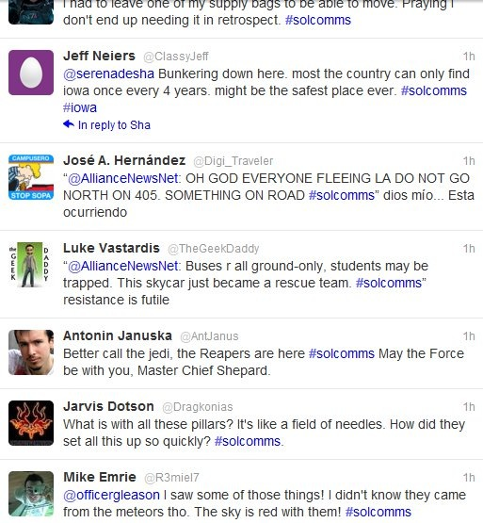

Slide 50
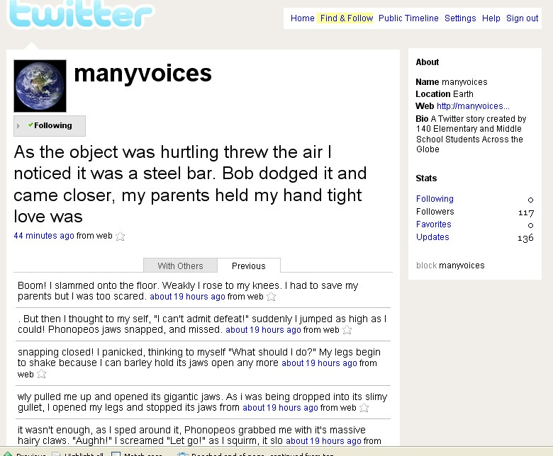

Slide 51
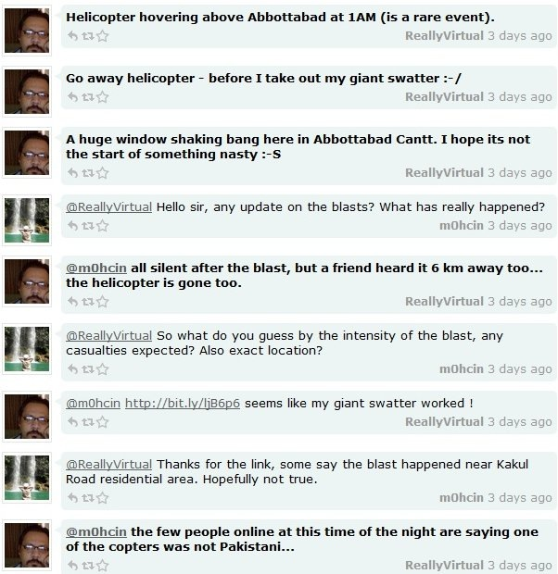

Slide 52
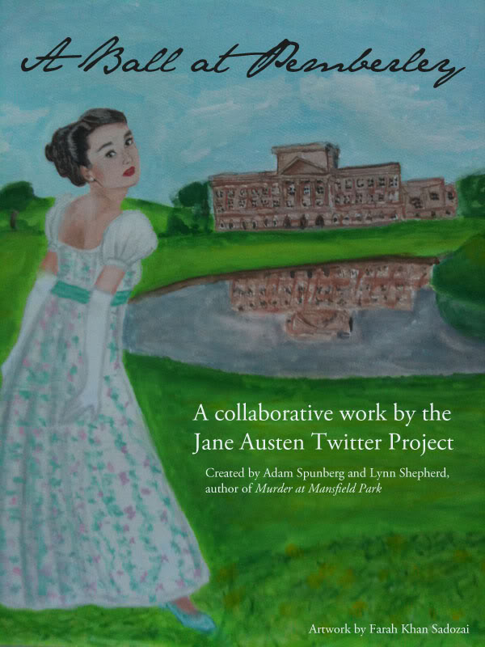
#A4T

Slide 53
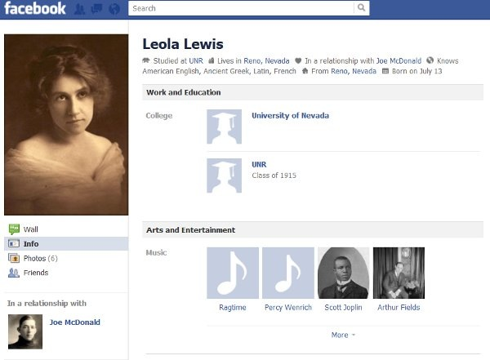

Slide 54
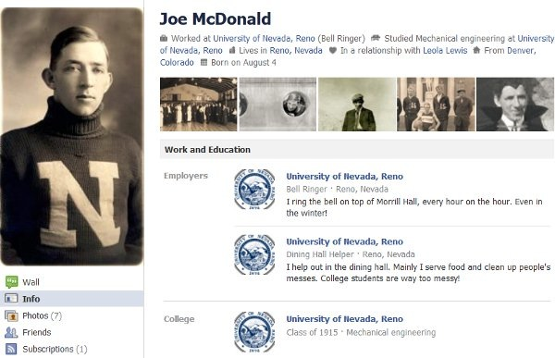

Slide 55
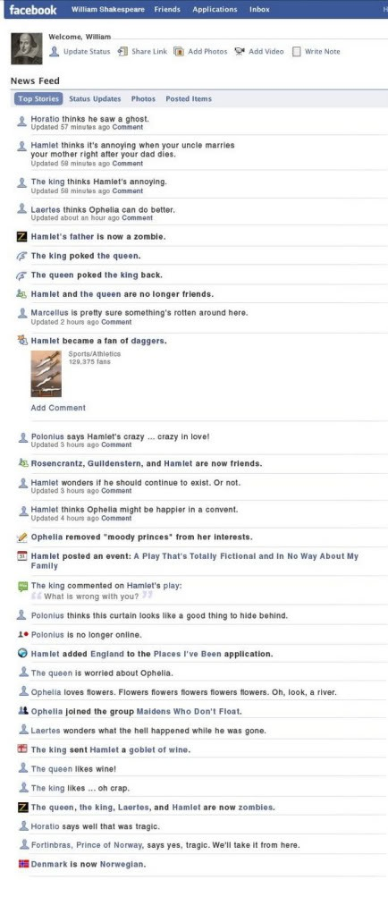

Slide 56
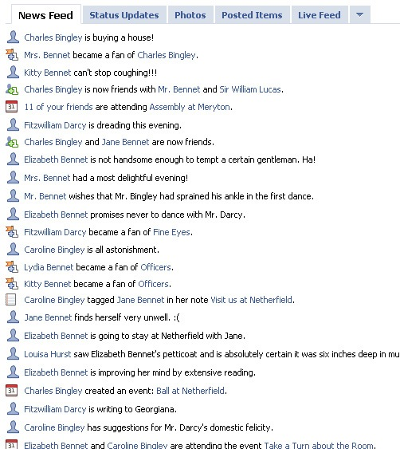

Slide 57
All over the Web
http://www.pepysdiary.com/
http://smalltownnoir.com/
http://newdigitalstorytelling.net/2011/05/15/storytelling-by-twitter-three-line-novels/
http://www.facebook.com/zytomirski

Slide 58
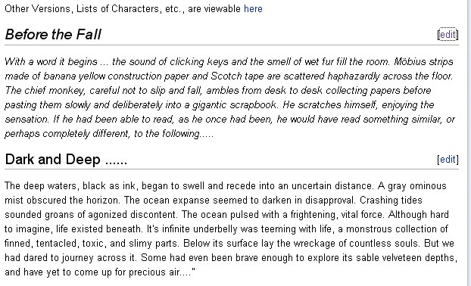
Wikistorytelling
(http://www.amillionpenguins.com/wiki/index.php/Main_Page)

Slide 59
Can a collective create a believable fictional voice? How does a plot find any sort of coherent trajectory when different people have a different idea about how a story should end – or even begin? And, perhaps most importantly, can writers really leave their egos at the door?
“About”,
http://www.amillionpenguins.com/wiki/index.php/About

Slide 61
Embedded within Slideshare Web platform apparatus

Slide 62
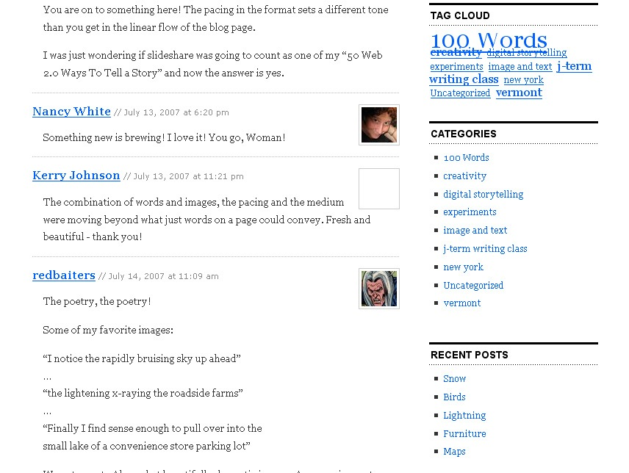
Embedded within blog

Slide 63
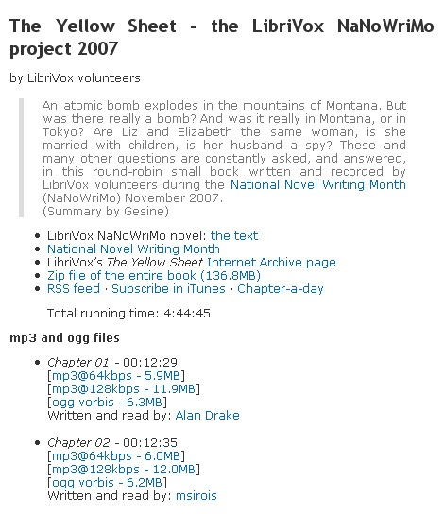
Storytelling by podcast
The Yellow Sheet, by Librivox team (2007)
Text then podcast
http://librivox.org/the-yellow-sheet-by-librivox-volunteers/

Slide 64
Storytelling by podcast

Slide 65
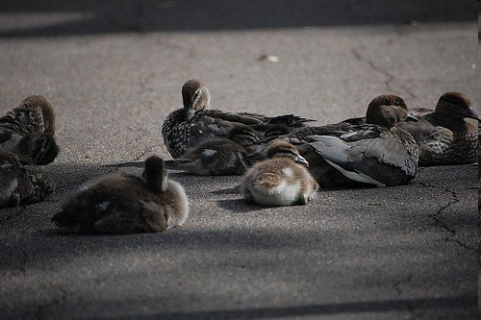
Flickr and storytelling
Tell a story in 5 frames group
“The Chase”
(Benjamin!, 2009)
http://flickr.com/groups/visualstory/discuss/72157611666013264/

Slide 67
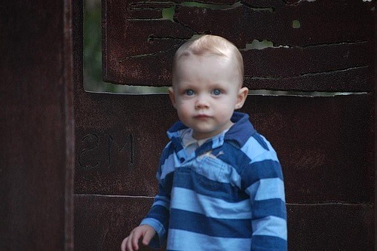

Slide 68
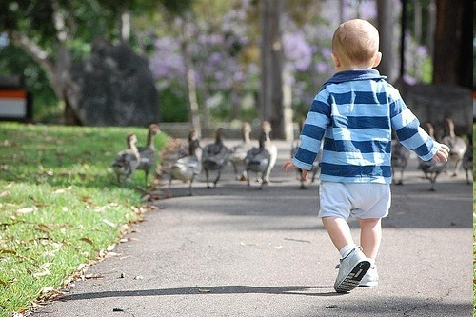

Slide 69
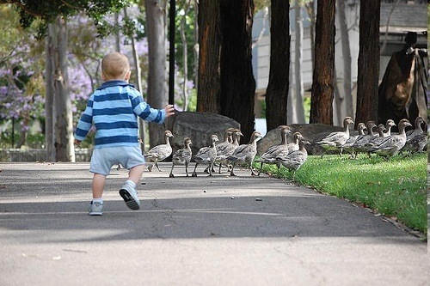

Slide 71
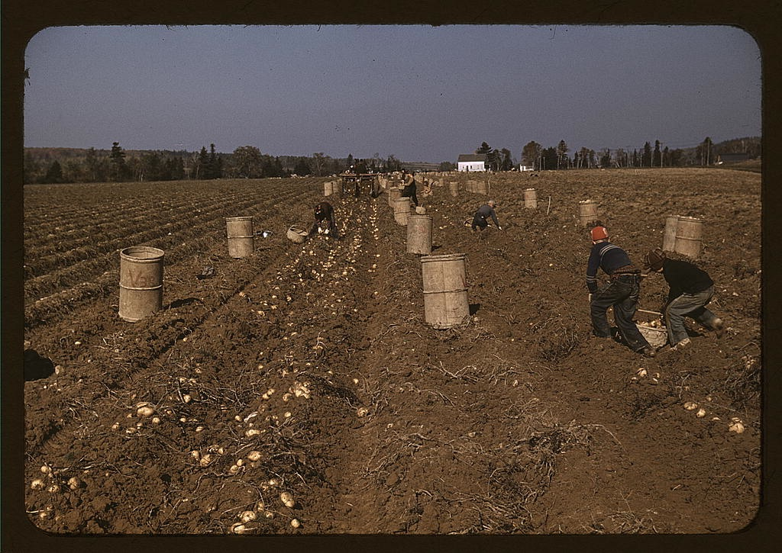
Remixing
Example: "Farm to Food", Eli the Bearded (2008)

Slide 73
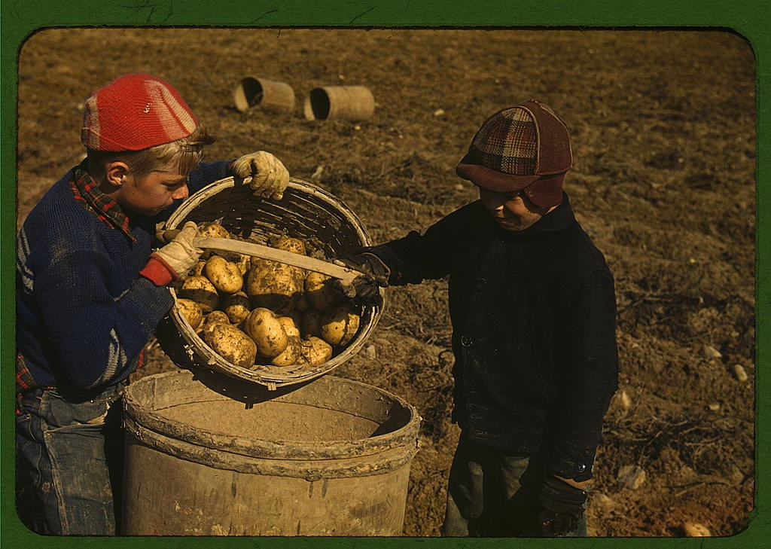
Social photo stories

Slide 74
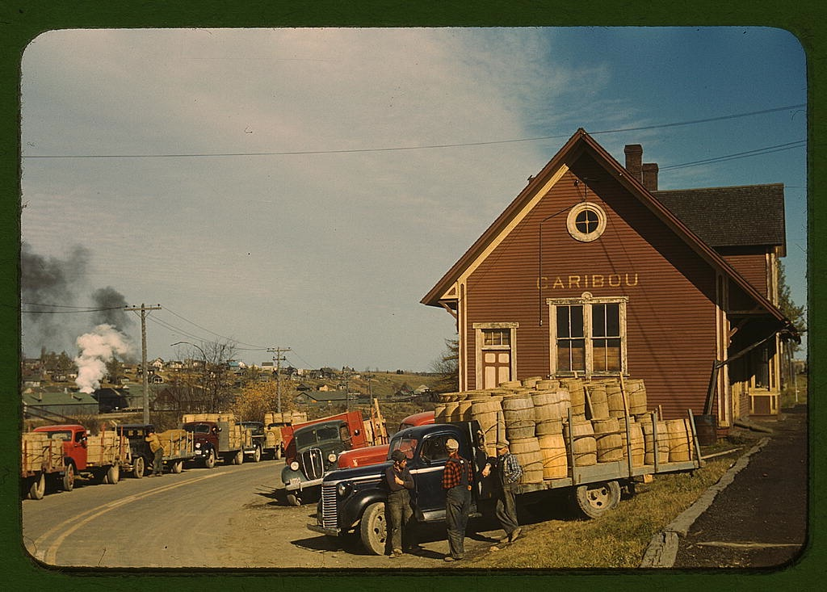
Social photo stories

Slide 75
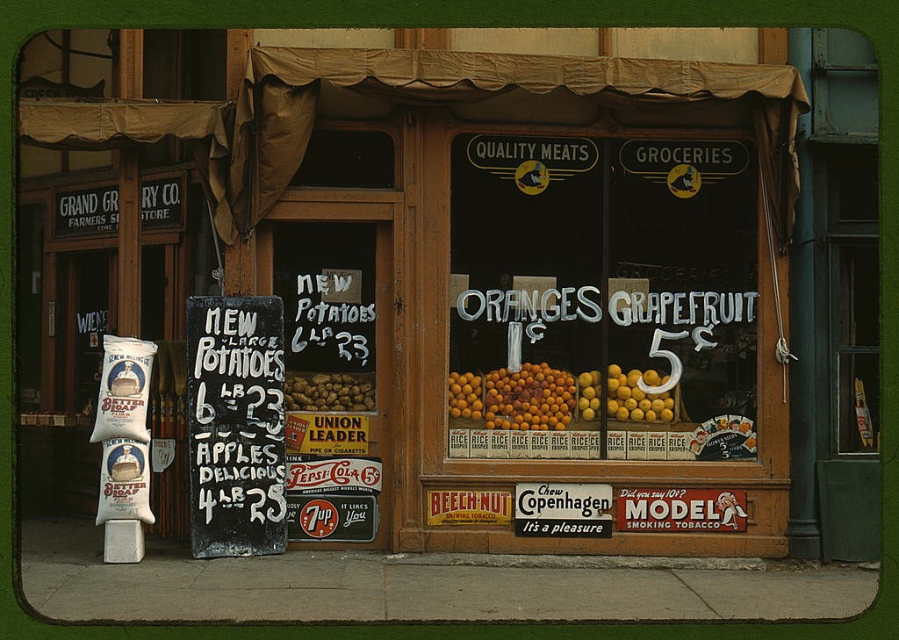
Social photo stories
Flickr, Tell A Story in Five Frames group (http://www.flickr.com/groups/visualstory/)
Example: "Food to Farm", Eli the Bearded (2008)

Slide 76
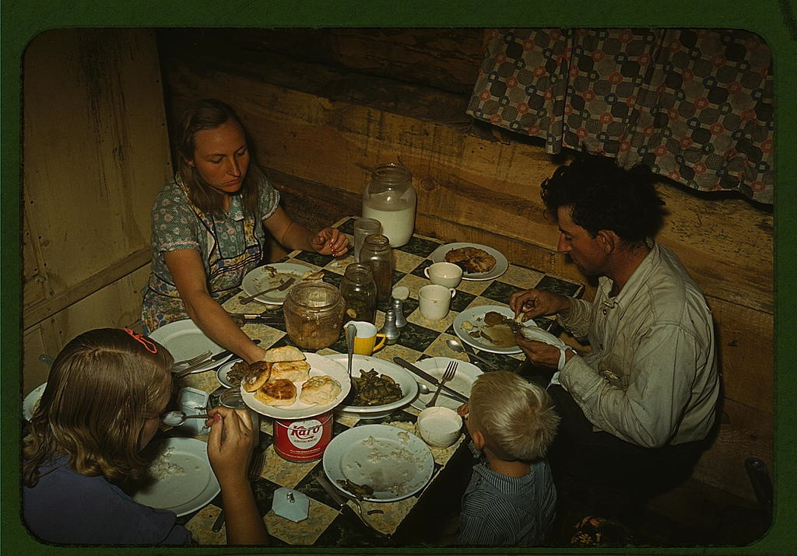
Social photo stories
Example: "Food to Farm", Eli the Bearded (2008)

Slide 77
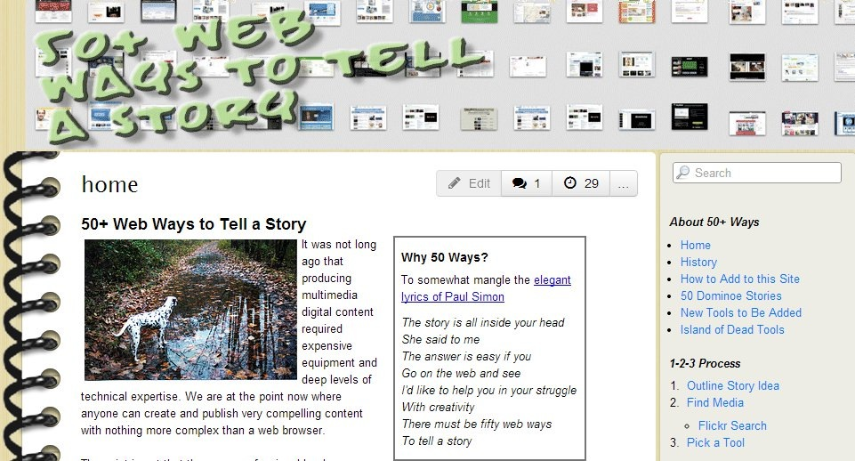
http://50ways.wikispaces.com/

Slide 79
Gaming as part of mainstream culture
Median age of gamers shoots past 30
Industry size comparable to music
Large and growing diversity of platforms, topics, genres, niches, players
Impacts on hardware, software, interfaces, other industries

Slide 80
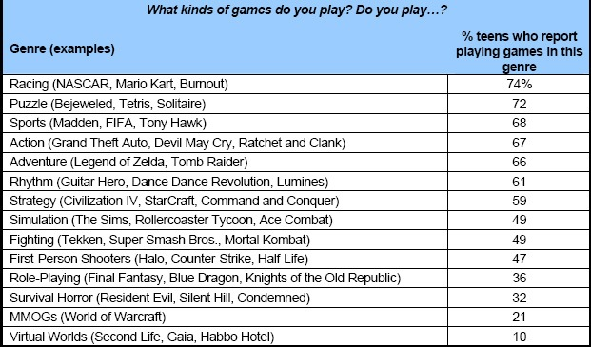
Diversity of game genres American teenagers, Pew Internet, 2008

Slide 81
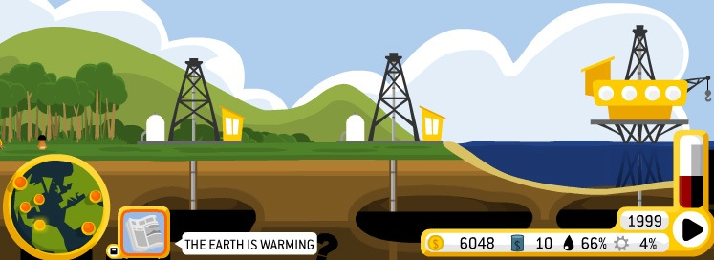
Games serious, public, and political
Oiligarchy, Molle Industries
Jetset, Persuasive Games
The Great Shakeout, California
DimensionM, Tabula Digita

Slide 82
Story in games?

Slide 83
Key principles
Branching narratives
Radically interactive (Arseth)
Exploration of an encyclopedic space (Manovich)

Slide 84
Key principles
Procedural generation (Murray)
Roles and role play (Gee)
Cinematics

Slide 85
Interactive fiction

Slide 86
Syntheses

Slide 91
Classroom and courses
Curriculum content
Delivery mechanism
Creating games
Peacemaker, Impact Games
Revolution (via Jason Mittell)

Slide 92
More technologies

Slide 95
VR tech now

Slide 96
AR game stories
Pokemon Go, Ingress, Zombies Run!
https://www.wired.com/2011/09/augmented-reality-zombies-run-augmented-audio/

Slide 97
MR?

Slide 98
In higher education
Student-created stories
Faculty-” “
Administration-” “
Research
Classes, certificates, degrees

Slide 99
Pedagogical principles
Constructivism
Student voice discovery + development
Media defamiliarization
Outreach to media-drenched generation
Job skills

Slide 100
Key starting questions
Who produces?
Personal or impersonal stories?
Who supports?

Slide 101
Workflow and process
1. Preparation
Curricular integration
Pedagogical “
Integration into syllabus, assessment
Platform selection
Support strategy determination

Slide 102
Workflow and process
2. During the class
Explanation
[project(s) - see next slides]
Assessment
Group presentation

Slide 103
Workflow and process
Project structure, Storycenter model:
Determine story idea
Writing voiceover
Recording “
Into the video editor
Assembling other media
Edit edit edit edit
Publication
story circle 2-3x/day

Slide 104
Workflow and process
Project structure, media-centric/remix model:
Capture and/or assemble media
Work into story form
Move into editor
Integrate other media
Edit edit edit edit
Publication

Slide 105
Workflow and process
Staged increases in complexity
Assignments by medium
Interwoven through other classwork

Slide 106
Workflow and process
3. Afterwards
Archiving
Selection of exemplary work
Lessons learned ->notes for next time

Slide 107
Curricular integration
Disciplinary (journalism, writing, anthropology, etc)
Writing program (WAC)
General education requirements
Job skills
Media literacy
Student life/support

Slide 108
Support strategies
Peer support
IT
Media services: hardware + software
Academic computing
library: space, staff, copyright, archiving
collaboration off-campus
YOU

Slide 109
Assignments
Storycenter personal prompt
Reaction to material
Creative writing/composition
Mix DS into non-DS work
Class materials about storytelling, including exemplary stories
Meta commentaries
example: combine media to describe something in music history; past, a theme for a concert

Slide 110
Some quick and dirty PM
SCOPE IS CRITICAL
Determine milestones
Build in risk (minimum: 15%)

Slide 111
Assessment
Process versus final product
Peer and self-assessment
Assess in stages (plan, draft, final)
Summative or constructivist?
Draw on pre-existing strategies (content and form)
Generate rubrics

Slide 112
Rubrics
Jason Ohler’s series: http://www.jasonohler.com/storytelling/assessmentWIX.cfm
Gail Matthews-de Natale: https://net.educause.edu/ir/library/pdf/ELI08167B.pdf
University of Houston: http://digitalstorytelling.coe.uh.edu/archive/pdfs/samplerubric.pdf , http://digitalstorytelling.coe.uh.edu/archive/DS-Project-Guidelines-2010.html

Slide 113
Tools for storytelling
Hardware
PC or Mac
Tablets
Phones
labs, offices, mobile, personal

Slide 114
Tools for storytelling
Images
PS, GIMP, iPhoto
Maps: Google Earth, collections
Comic Life
Audio
Audacity, Garageband
video editors

Slide 115
Tools for storytelling
Audio
Audacity, Garageband
various mobile apps
video editors

Slide 116
Tools for storytelling
Video
PC: MovieMaker, Premiere
Mac: iMovie, FinalCutPro
Browser: WeVideo, https://www.youtube.com/editor
Mobile: various apps

Slide 117
Tools for storytelling
Social media
Blogger; WordPress
Twitter
Facebook

Slide 118
Tools for storytelling
Misc. multimedia
VoiceThread
Cowbird
Gaming
GameMaker, Twine, Inform
Tabletop: DIY

Slide 119
Publication sites
DVDs, thumb drives
Local network space
Custom-built website
Social media (Flickr, Facebook, Google+, etc.)
iTunes
YouTube

Slide 121
http://bryanalexander.org bryan.alexander@gmail.com http://twitter.com/bryanalexander

